Slide 1
Science - Fossils
Week 5 – Home Learning

Slide 2
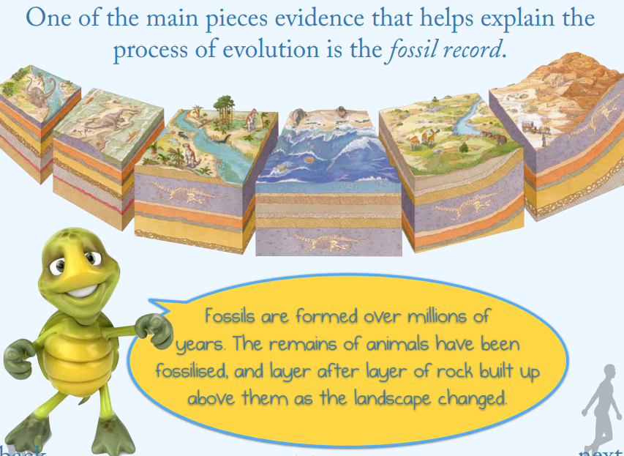
Science - Fossils
Week 5 – Home Learning

Slide 3
Science - Fossils
Week 5 – Home Learning

Slide 4
Science - Fossils
Week 5 – Home Learning

Slide 5
Science - Fossils
Week 5 – Home Learning

Slide 6
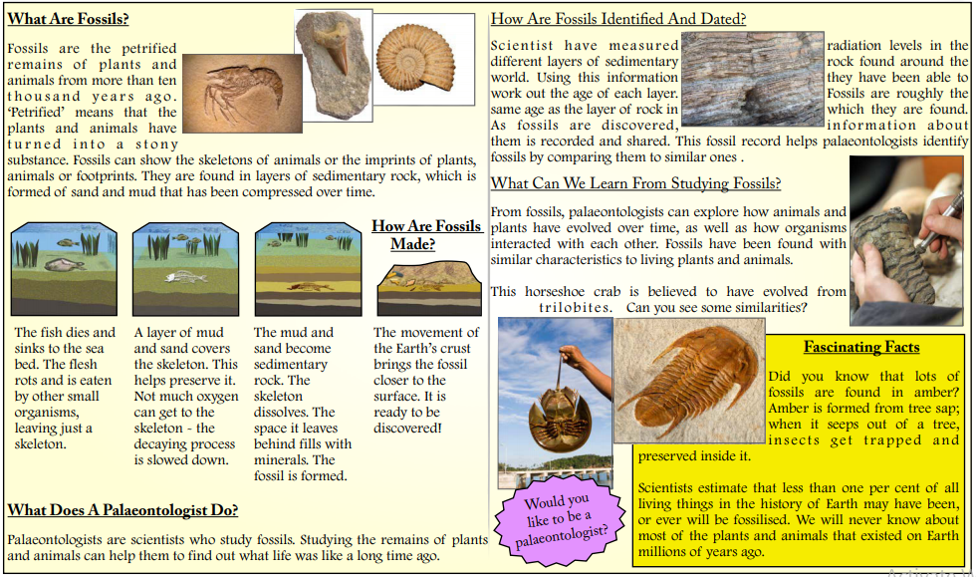
Science - Fossils
Fossil Facts Poster
Week 5 – Home Learning

Slide 7
Science - Fossils
Week 5 – Home Learning
How are fossils made: https://www.bbc.co.uk/bitesize/topics/z9bbkqt/articles/z2ym2p3
What can we learn from fossils: https://www.bbc.co.uk/bitesize/topics/z9bbkqt/articles/z22g7p3

Slide 8
Science - Fossils
Week 5 – Home Learning
Independent Challenges
It’s now time to show me what you ‘really’ know about fossils by completing the two independent challenges below:
Create your own timeline of the fossilisation process using pictures and text to clearly explain how fossils are made.
Create an information booklet titled ‘Fascinating Fossils...’. Use your understanding of everything that you’ve read to make the most informative guide that you can. Remember to make it appealing to the reader as well as easy to follow.
– Please email this task to Mrs Murdy by 11.05.20.
Optional Extra: Can you make your own fossil?

