Slide 1
THE VICTORIANS
By Luke Hall and Isabel Foggon

Slide 2
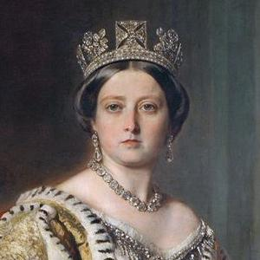
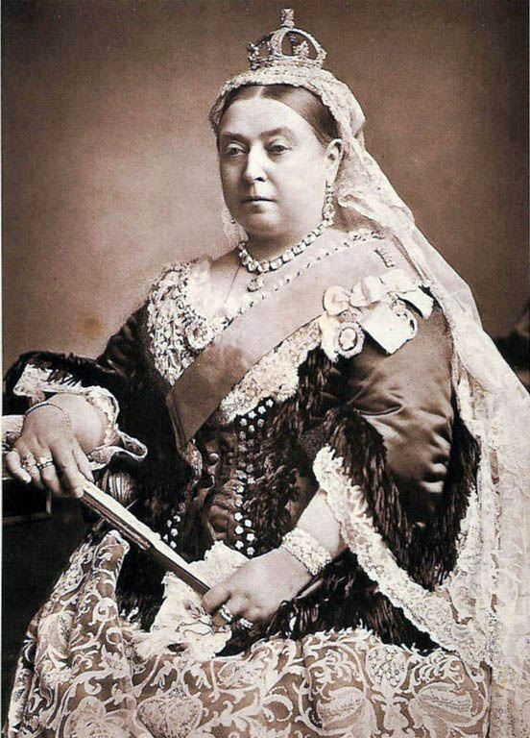
Queen Victoria
Queen Victoria was 18 when she became Queen.
She is the great great grandmother of Queen Ellizibeth II
When her husband died she only wore black

Slide 3
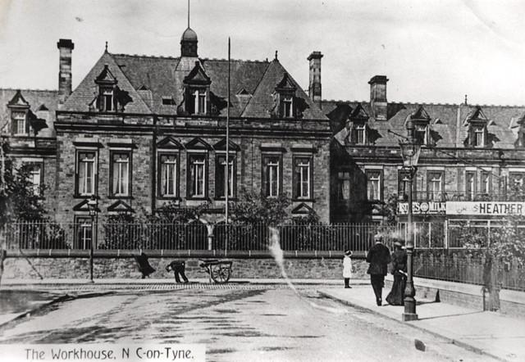
The workhouse
THE WORKHOUSE!!
The workhouse dreaded place weir you were put if you could not care for your family or you were an orphan or really poor.

Slide 4
Victorian schools
1.The teachers were really strict!
2.The children got really scared of the teachers in the schools.
3.They had to use a fountain pen, chalk and slate quill and ink.

Slide 5
Victorian punishments
1.One punishment is the cane used by teachers to give them wrong.
2.One was if a boy was being a nuisance they had to sit beside girls and the teacher would call him miss for the rest of the day and his friends would laugh.

Slide 6
Rich VS poor
The rich lived in big houses and lived a better life.
The poor had lots of famous authers that wrote about the poor people.

Slide 7
THE END!!!!!

