Slide 1
Victory in Europe Day
World War 2 – VE DAY
Unrestricted
Unrestricted

Slide 2
1939 – Nazi Germany invaded Poland.
Germany invaded Poland in 1939 to regain lost territory and ultimately rule their neighbour to the east. The German invasion of Poland was how Hitler intended to wage war in what would become known as the “blitzkrieg” strategy.

Slide 3
How did the United Kingdom get involved?
In September 1939 the United Kingdom declared war on Nazi Germany after Germany invaded Poland.
Japan got involved in December 1941, shortly after it attacked British colonies in Asia.

Slide 4
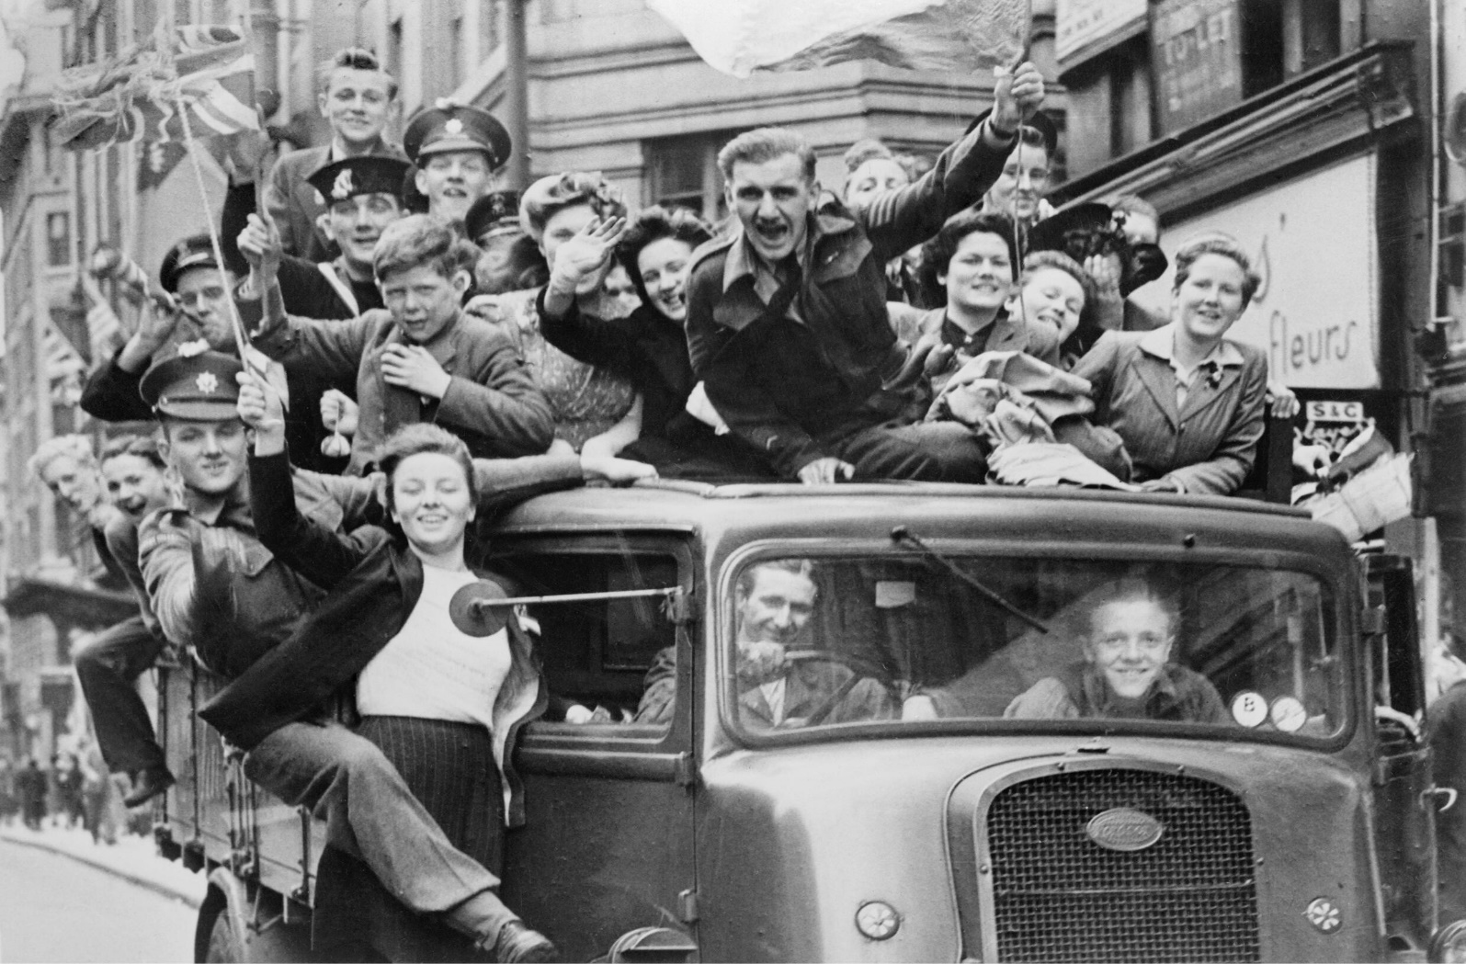
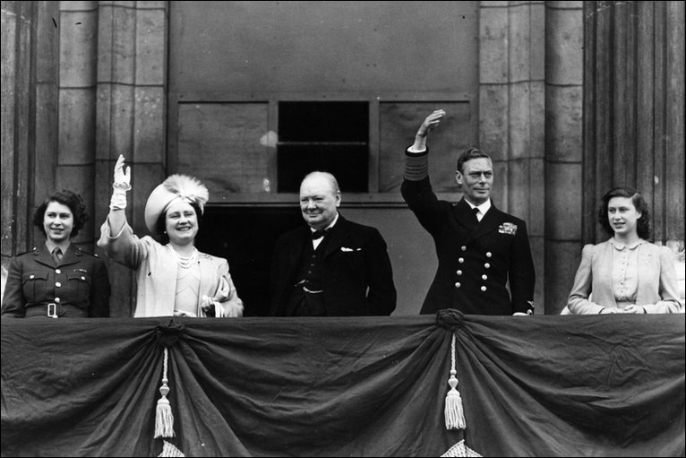
World War 2:
World War 2 went on for 6 years from 1939 – 1945. Luckily for England, WW2 only lasted for 4 years because of Germanys surrender. Prime Minister Churchill made his speech at exactly 3pm in the afternoon on the 7th of May, and that was when VE day began. People celebrated all through the night, with bonfires, bunting, meals, dancing and a royal wave from the Royal Family!

Slide 5
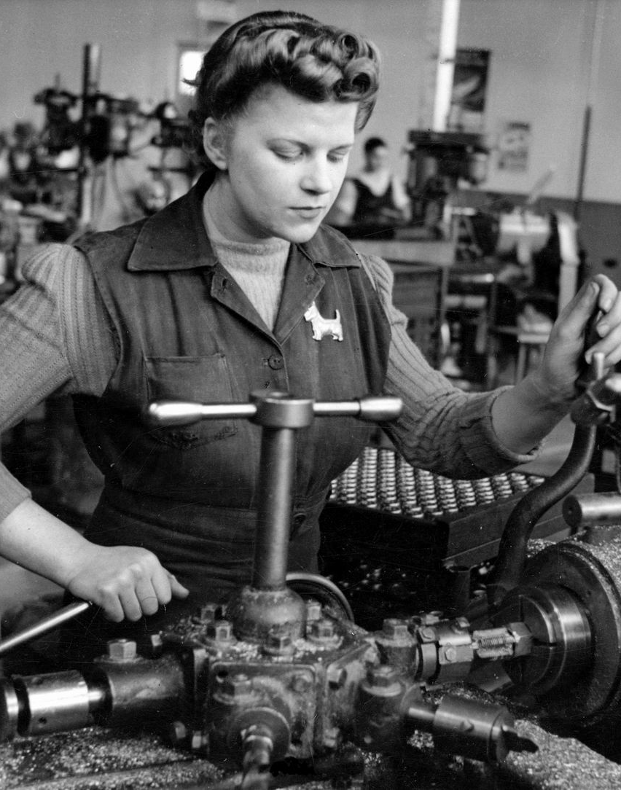
Do you think Women should have kept their important roles of working after WW2!
After World War 2, Women were not allowed to keep their important roles so that the men could return to their jobs.
This was so unfair to Women, so in 1944 the US Women’s department took a survey of women. Thanks to them Women have important roles today.
This Photo by Unknown Author is licensed under CC BY

Slide 6
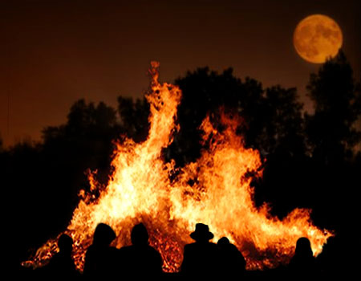
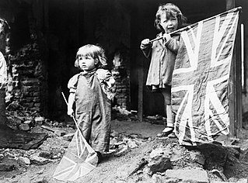
There were massive bonfires all through the night, with people singing and dancing in a circle.
Lots of people had flags, bunting or other decorations.
This Photo by Unknown Author is licensed under CC BY-NC-ND

Slide 7
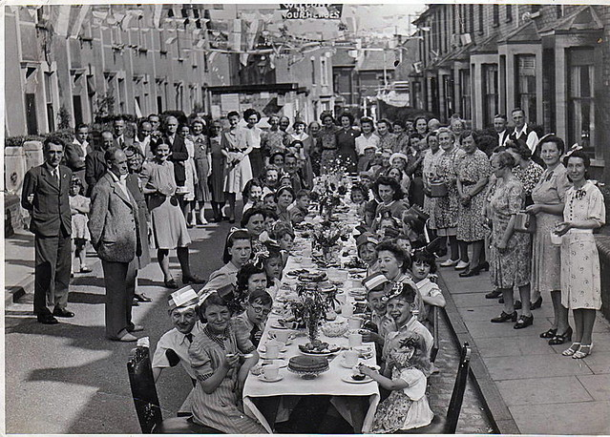
VE Day Celebrations!
People celebrated with delicious food, massive, bright bonfires and lots of colourful British bunting.
Even though people celebrated in lots of different ways, that doesn’t mean every single man had come back to Britain.
Some were captured by other Countries, some were very ill in Hospital and many were dead. About 70-85 million people died in World War 2.
Many in Britain celebrated with lots of expensive food and drink, with beautiful china, and blue and red flowers.
These people would normally have children or young family’s.

Slide 8
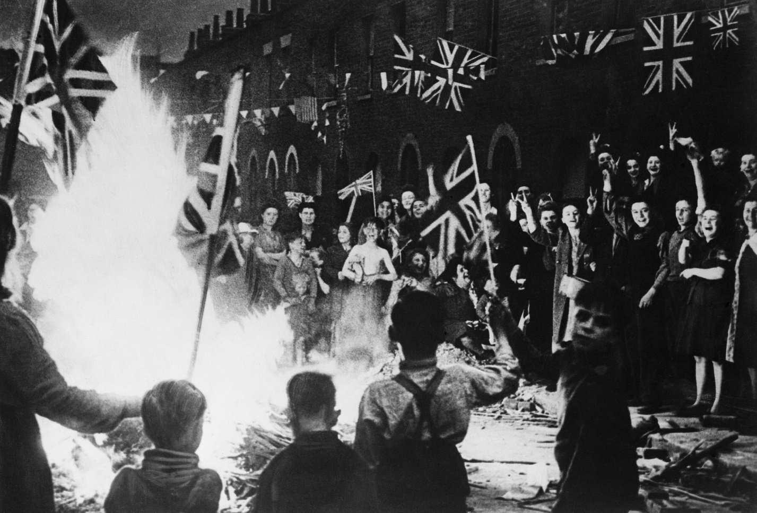
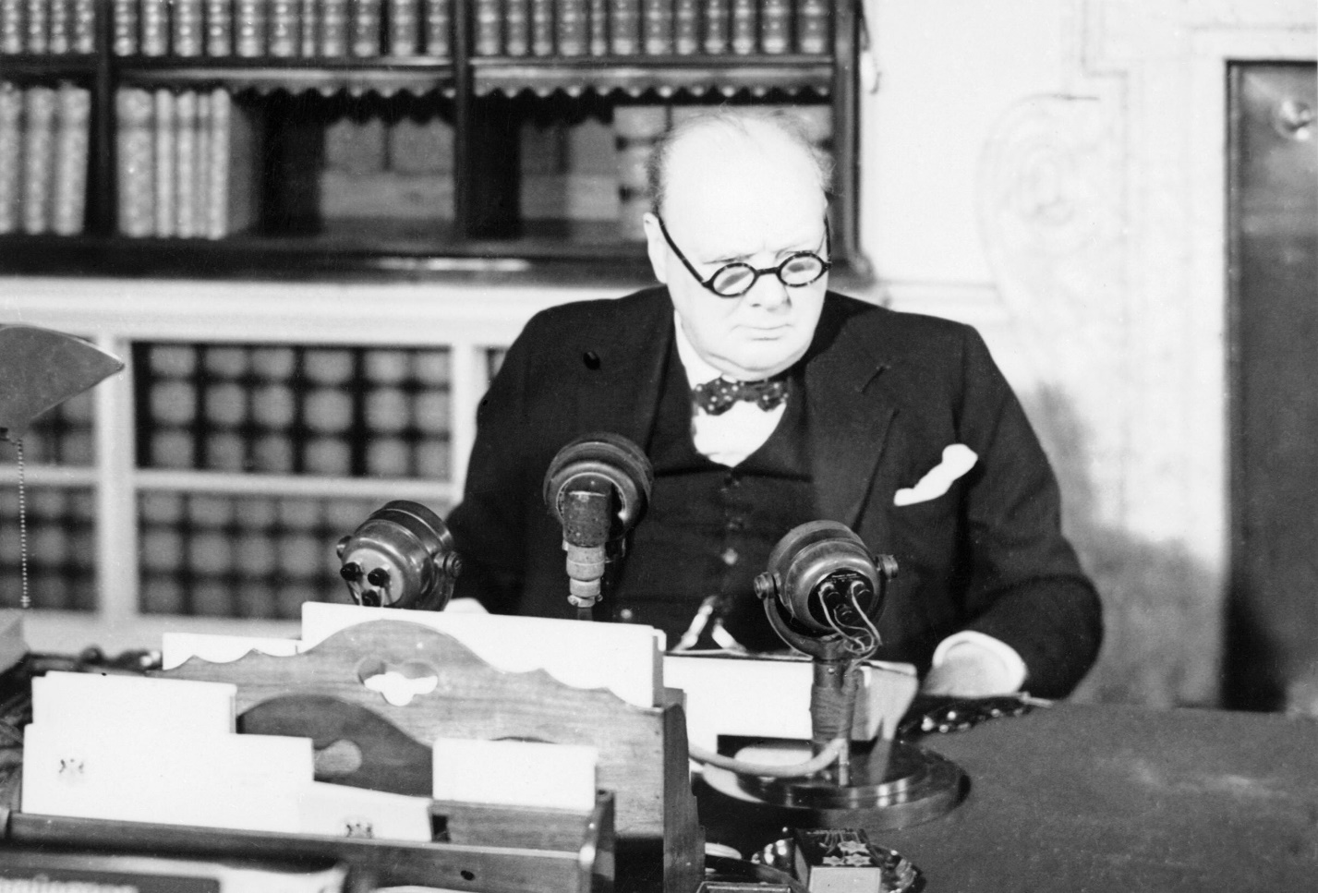
Victory in Europe Day
By Thea

