Slide 1
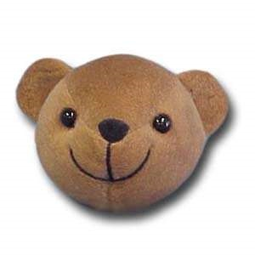
Teddy Turns

Slide 2
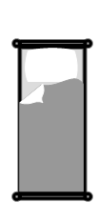
A whole turn
A whole turn is where you turn all the way around and end up facing the same way!
Teddy starts by facing the bed, he turns all the way around on the spot and ends up facing the bed again!

Slide 3
A half turn
Teddy starts by facing the bed, he decides to complete half a turn and ends up facing the armchair!
A half turn is where you turn on the spot to face the opposite way!

Slide 4
Left
Right
Can you copy Teddy?

Slide 5
Quiz
Is this a whole turn or half turn?
Whole turn

Slide 6
Quiz
Is this a whole turn or half turn?
Half turn

