Slide 1
All about zoo animals
By Elliot Chapman

Slide 2
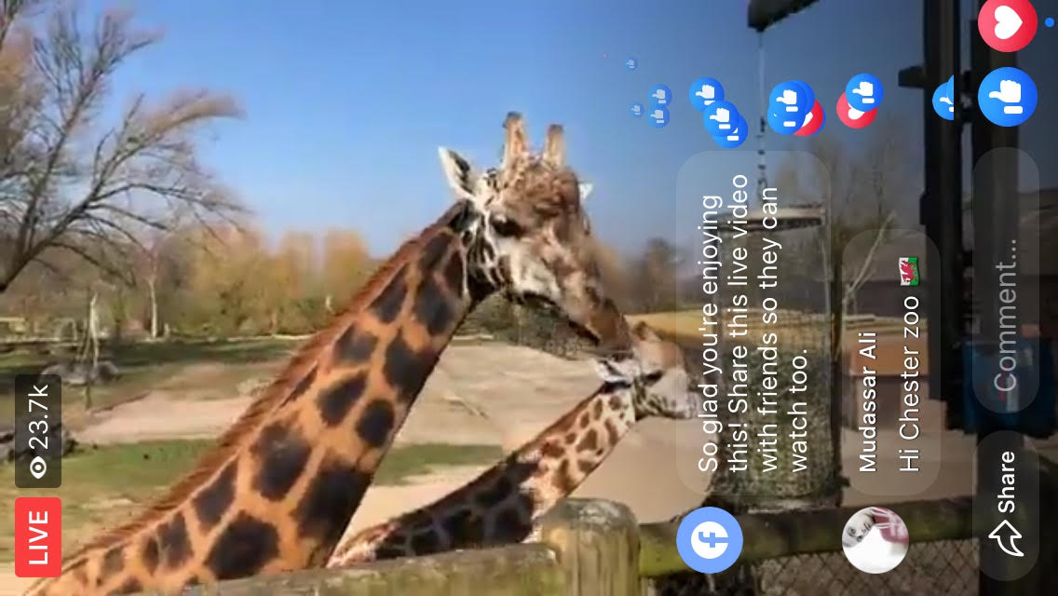
Giraffe
They have a purple tongue to help them in the African heat.
They have four stomachs like a cow and their poo is the size of maltesers and doesn’t smell.
New born giraffes are taller than most adult humans (6 feet)
Every giraffe has a different coat patterns like finger prints

Slide 3
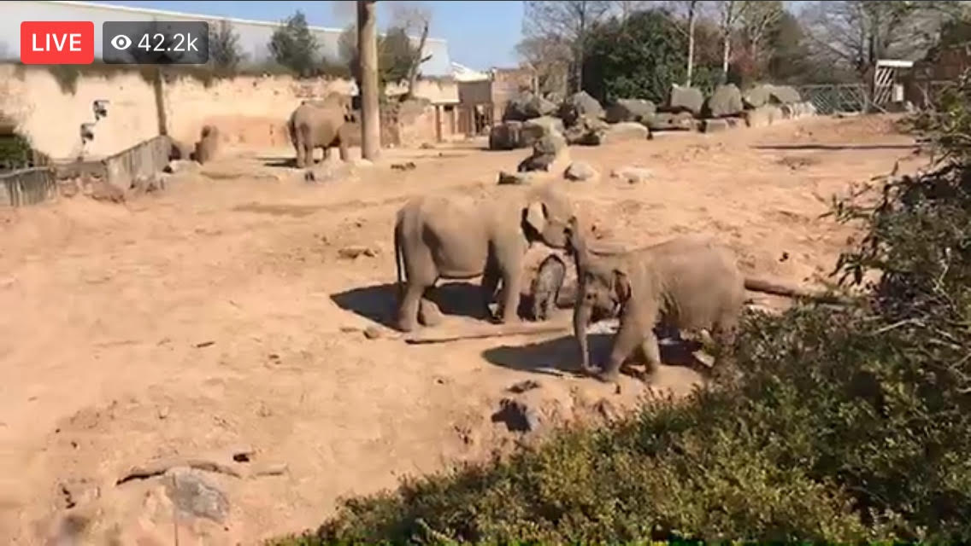
Elephant
Asian elephants have smaller ears and there are 14,ooo in the world
They eat for 16 hours a day
Only male Asian elephants have so they get hunted a lot for their I vary
They use dust for suncream.

Slide 4
Sun Bear
They have fun fruit treats of watermelon, grapes and sweet corn.
Their long tongue is 25cm long and helps them eat bugs and honey in crevices
They’re also known as honey bears
They are names sun bears because their chest is like the rising sun.

Slide 5
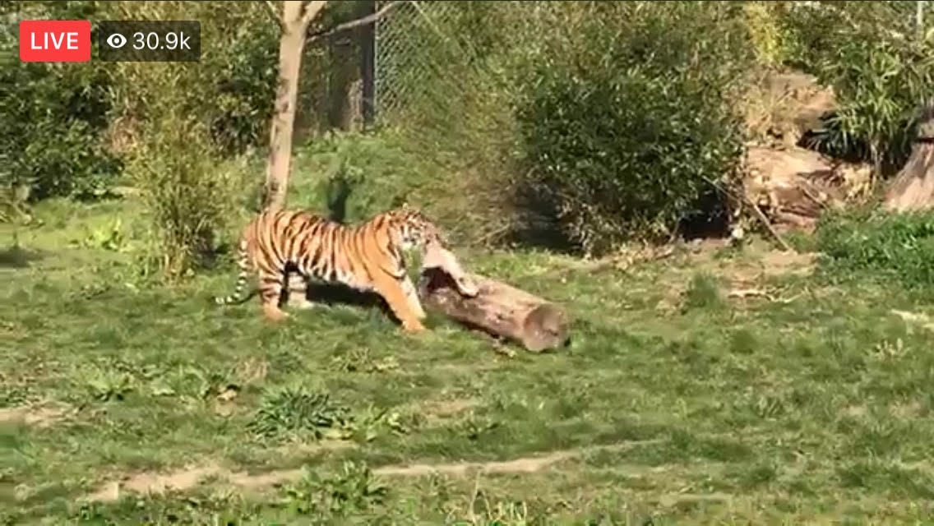
Tiger
Their stripes help them camouflage in bamboo and bushes.
Sumatran tigers are the smallest, they’re critically endangered because there are only 400 left in the wild.
They live in Sumatra where palm oil is harvested.
Their tongue is like Velcro to lick all the leftover meat off the bones

