Slide 1
A film review by William of…...

Slide 3
The story is about a step dad called Brad (played by my favorite actor Will Ferrell) is trying hard to get his step kids to love him, this was going well until their real dad comes for a visit and there is a war to see who is the best dad.
Dusty (played by Mark Wahlberg) is the kids real dad and is robust,brave and really cool however on the other hand Brad is the opposite of all stuff that Dusty is. My favorite part of the film is when Brad tries to look really cool like Dusty. Brad tries to ride Dusty’s motorbike and then drives it through the house, up the stairs and...well you can see the the results on the next page...

Slide 4
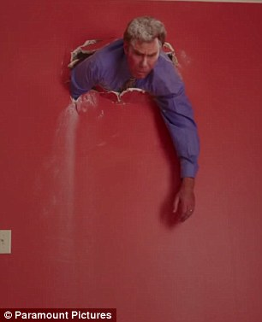
oops!!!

Slide 5
The film is really funny and enjoyable because it has 2 of the most funniest actors in the world Will Ferrell and Mark Wahlberg who work really well together and have been in other films such as The other guys and Daddys home 2.
I think you will like it because it has a lot of humor, makes you happy and tells you about real life situations like step parenting and relationships.
I recommend you watch it because it is the most harlariust film that I have watched in a long time.

