Slide 1
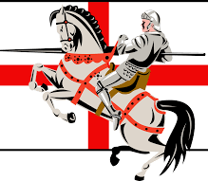
ST George by Dylan

Slide 2
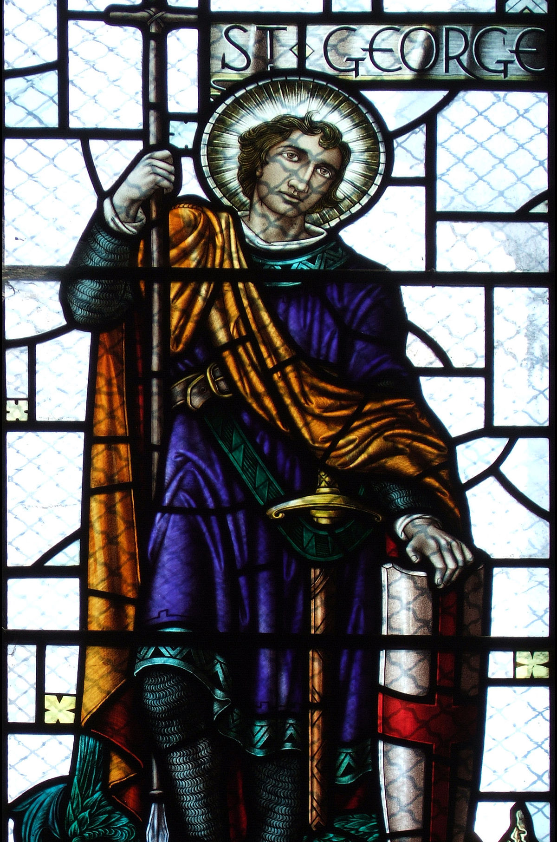
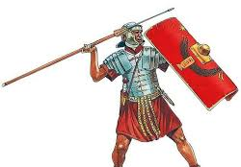
Before the dragon
St George was born in the 3rd century in Cappidda, now known as Turkey.
His parents were Christian, so he followed that religion.
George wasn’t a knight like people made him out to be he was a roman solider.

Slide 3
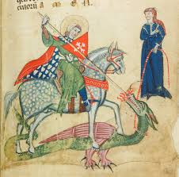
The dragon!
One day St George heard a dragon was terrorising a town called Libya.
The town had to sacrifice a beautiful maiden every day and the dragon would kill her.
The last maiden remaining was the kings daughter, the princess.
So George set off to find the dragon on his horse with a lance , shield and sword .
When he finally arrived at Libya, he saw a cave, and he knew that this is were the dragon would be.
The dragon stepped out feeling over confident. George charged on his horse but when his lance touched the dragon it smashed into a million pieces, and he fell off his horse.
He spent some time hiding so he could regain strength.
Then after he regained strength he ran out and stabbed the dragon and saved the princess.

Slide 4
After the dragon
St George was well respected after slaying the dragon. People protected St George, after slaying the dragon he went back to being a solider for the emperors royal Guard.
As I said earlier he was a Christian, the emperor thought this was wrong, so he tortured St George until he died.

Slide 5
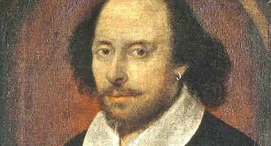
Extra information
Fact
Explosion
The dragon represented the devil.
The country Georgia is named after him .
Shakespeare died on the very same day as him.
He is also the patron Saint of Ethiopia, Georgia, Bulgaria, Greece, Portugal and Russia.
Buried in a town called Lod in Israel.
The English flag is St Georges’.
You have picnics on the day.
His flower is the red rose .

