Slide 1
Lesson One

Slide 2
The Blitz
Learning Objective:
To consider what ‘The Blitz’ was.
To investigate a poem written about the events.

Slide 3
The Blitz
Look through the pictures from the Blitz photo pack. For each picture think about:
1. What is happening in the photos?
2. What difficulties would the rescuers face?
3. How would it have felt to have been both the rescuer and the trapped person?
4. Write down a list of keywords relating to the situations depicted in the photographs.

Slide 4
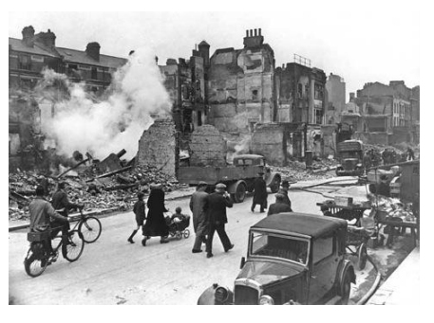
Write down a list of keywords relating to the situations shown in these photographs.
Milk man
devastation
rubble

Slide 5
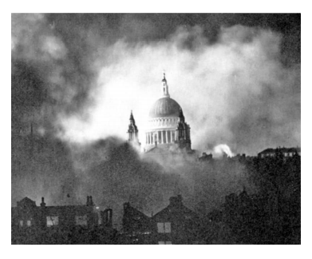
Write down a list of keywords relating to the situations shown in these photographs.
Smoke
Spitfire
Enemy

Slide 6
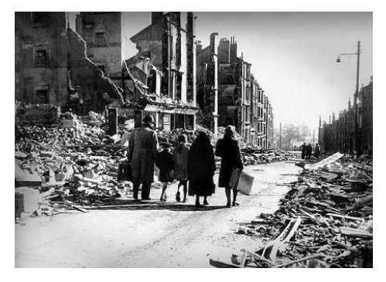
Write down a list of keywords relating to the situations shown in these photographs.
Homeless
Devastation
Families

Slide 7
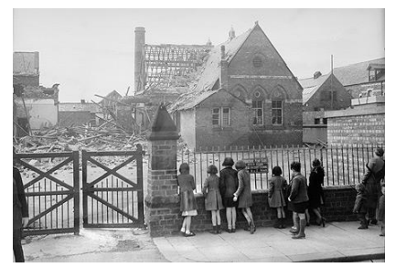
Write down a list of keywords relating to the situations shown in these photographs.
School
lost
children

Slide 8
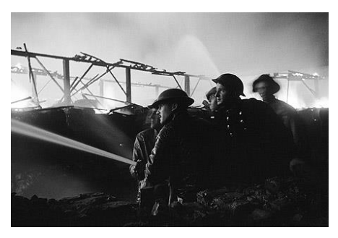
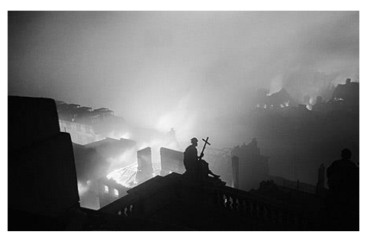
Write down a list of keywords relating to the situations shown in these photographs.
Fire
Soldiers
Bombs

Slide 9
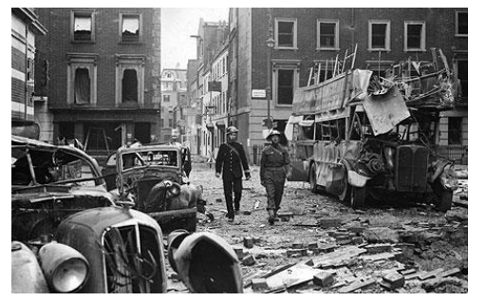
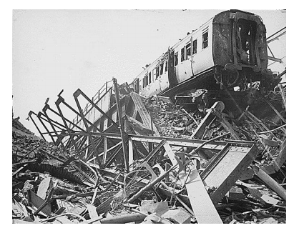
Write down a list of keywords relating to the situations shown in these photographs.
Public transport
Double decker bus
Trams

Slide 10
The Blitz
In your own words, based on the photos, what do you think the Blitz was?

Slide 11
The Blitz
Spend 10 minutes researching the Blitz.
Can you then add to your description of what it was?

Slide 12
Rescue, 1940 (A poem for Sarah)
Read the poem, ‘Rescue, 1940 (A poem for Sarah)’.
Highlight and label all of the poetic devices you can find in the poem. Consider if it uses any of the following:
Repetition
Alliteration
Similes and metaphors
Personification
Rhyming
Powerful verbs and adjectives
Any other devices you can find

Slide 13
Have a go…
Choose one of the pictures from the photo pack to write a verse about using the same structure with the opening “Air Raid ..” lines.

