Slide 1
Captain Tom Moore
Captain Tom Moore

Slide 2
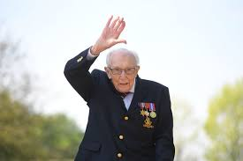
This is CaptainTom Moore.

Slide 3
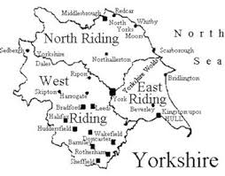
He was born at Keighley, in the West Riding of Yorkshire, on the 30th of April 1920.
He went to Keighley Grammar School and got an apprenticeship in civil engineering.

Slide 4
Captain Tom Moore was an officer in the British Army. He was in the army from 1939-1946. He has been to a lot of countries and met a lot of people.
Arakan
Mumbai
Cornwall
Kolkata
India
Sumatra

Slide 5
For his 100th birthday, he walked 100 laps of his garden to raise money for the NHS. Captain Tom raised over £32 million!
HE IS A ...

