Slide 1
What is a Fraction?
2 minute challenge
How many mathematical words can you think of in 2 minutes?
© Classroom Secrets Limited 2019

Slide 2
Fractions
© Classroom Secrets Limited 2019

Slide 3
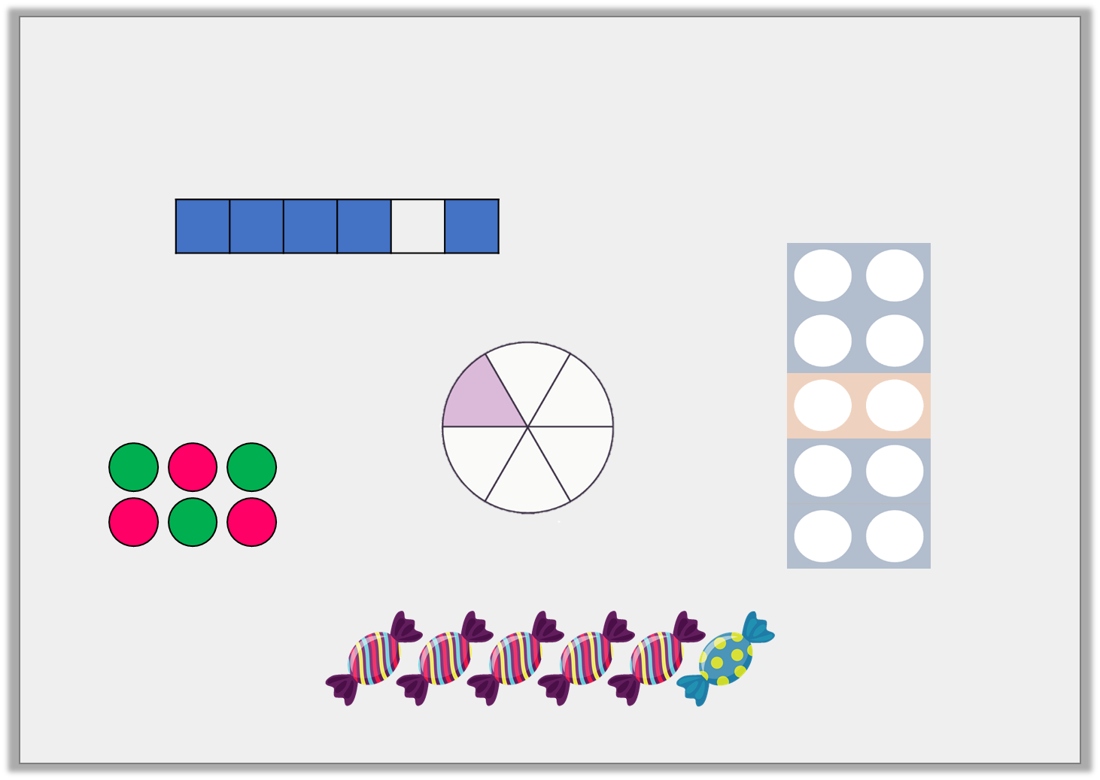
Warm up
Circle the images which represent .
1
6
© Classroom Secrets Limited 2019

Slide 4
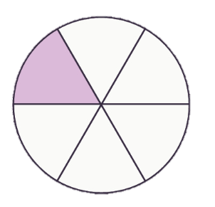
Were you right?
Circle the images which represent .
1
6
© Classroom Secrets Limited 2019

Slide 5
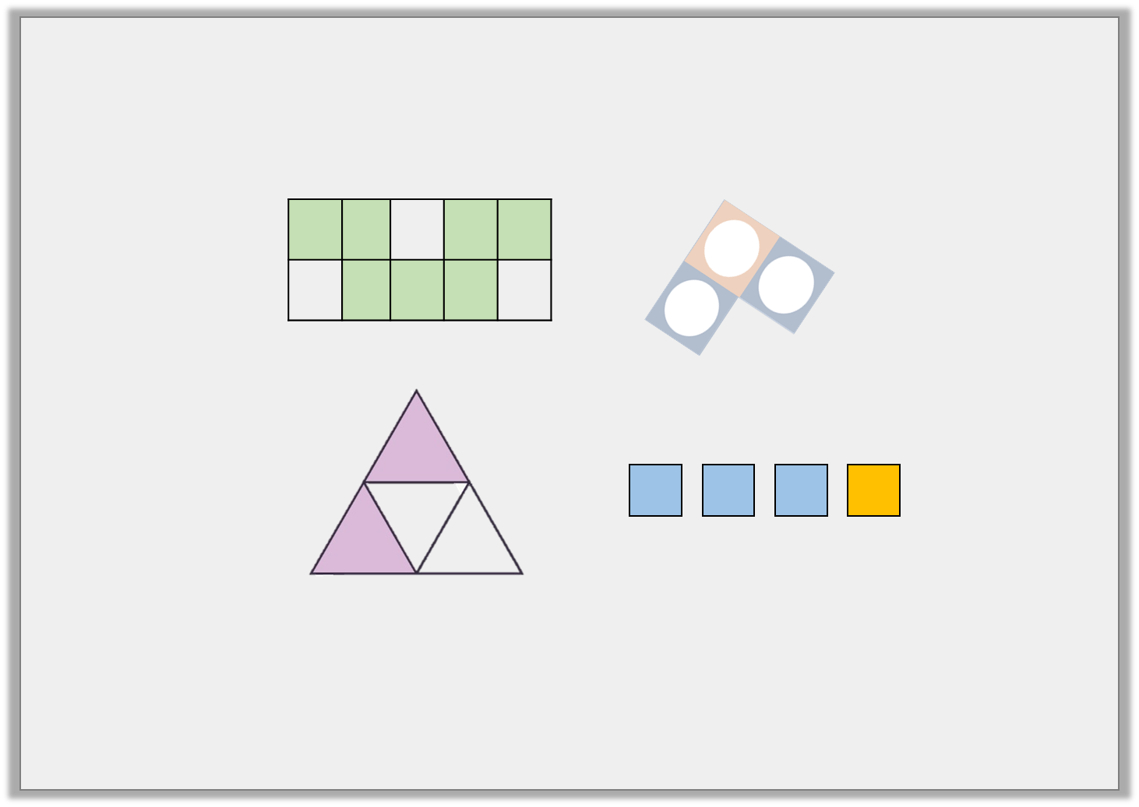
Varied Fluency 1
Circle the unit fractions.
Unit fraction: A unit fraction is a fraction where the numerator (top number) is 1 and the denominator (bottom number) is a whole number.
© Classroom Secrets Limited 2019

Slide 6
Varied Fluency 1
Circle the unit fractions.
Unit fraction: A unit fraction is a fraction where the numerator (top number) is 1 and the denominator (bottom number) is a whole number.
© Classroom Secrets Limited 2019

Slide 7
Varied Fluency 2
Match the fraction to the correct representation.
1
5
3
4
4
7
2
4
A.
B.
C.
D.
Top Tip
© Classroom Secrets Limited 2019

Slide 8
Varied Fluency 2
Match the fraction to the correct representation.
1
5
3
4
4
7
2
4
A.
B.
C.
D.
© Classroom Secrets Limited 2019

Slide 9
Place the following fractions on the number line below.
Follow along with me using paper. Just like we would in class.
4 |  |  | 11 |  |  | 2 |  |  | 6
12 |  |  | 12 |  |  | 12 |  |  | 12
0 |  |  |  |  |  |  |  |  |  |  |  | 1
Step 1: Count how many sections the line has been broken into.
© Classroom Secrets Limited 2019

Slide 10
Place the following fractions on the number line below.
Follow along with me using paper. Just like we would in class.
4 |  |  | 11 |  |  | 2 |  |  | 6
12 |  |  | 12 |  |  | 12 |  |  | 12
0 |  |  |  |  |  |  |  |  |  |  |  | 1
Step 1: Count how many sections the line has been broken into.
Step 2: It’s 6 how can we use this to make 12 sections like the denominator?
© Classroom Secrets Limited 2019

Slide 11
Place the following fractions on the number line below.
Follow along with me using paper. Just like we would in class.
4 |  |  | 11 |  |  | 2 |  |  | 6
12 |  |  | 12 |  |  | 12 |  |  | 12
0 |  |  |  |  |  |  |  |  |  |  |  | 1
Step 1: Count how many sections the line has been broken into.
Step 2: It’s 6 how can we use this to make 12 sections like the denominator?
Step 3: Using our knowledge of times tables we know 6 x 2 = 12. So we can add lines.
© Classroom Secrets Limited 2019

Slide 12
Place the following fractions on the number line below.
Follow along with me using paper. Just like we would in class.
4 |  |  | 11 |  |  | 2 |  |  | 6
12 |  |  | 12 |  |  | 12 |  |  | 12
0 |  |  |  |  |  |  |  |  |  |  |  | 1
Step 1: Count how many sections the line has been broken into.
Step 2: It’s 6 how can we use this to make 12 sections like the denominator?
Step 3: Using our knowledge of times tables we know 6 x 2 = 12. So we can add lines.
Step 4: As the denominators are all the same we can use the numerator to tell us where to place the fraction. You try it on a piece of paper
© Classroom Secrets Limited 2019

Slide 13
Were you right?.
4 |  |  | 11 |  |  | 2 |  |  | 6
12 |  |  | 12 |  |  | 12 |  |  | 12
0 |  |  |  |  |  |  |  |  |  |  |  | 1
2
12
4
12
6
12
11
12
© Classroom Secrets Limited 2019

Slide 14
True or false? Three eighths is show below.
2 minute challenge: Can you write the 3 steps before 1 minutes is up?
© Classroom Secrets Limited 2019

Slide 15
True or false? Three eighths is show below.
2 minute challenge: Can you write the 4 steps before 1 minutes is up?
Step 1: Count how many dots there are. This will give us the denominator.
Step 2: Count how are blue? This will give the numerator for 1 fraction.
Step 3: Count how are orange? This will give the numerator for another fraction.
Step 4: Answer the question.
© Classroom Secrets Limited 2019

Slide 16
Were you correct?
True or false? Three eighths is show below.
False; it shows or .
3
9
6
9
© Classroom Secrets Limited 2019

Slide 17
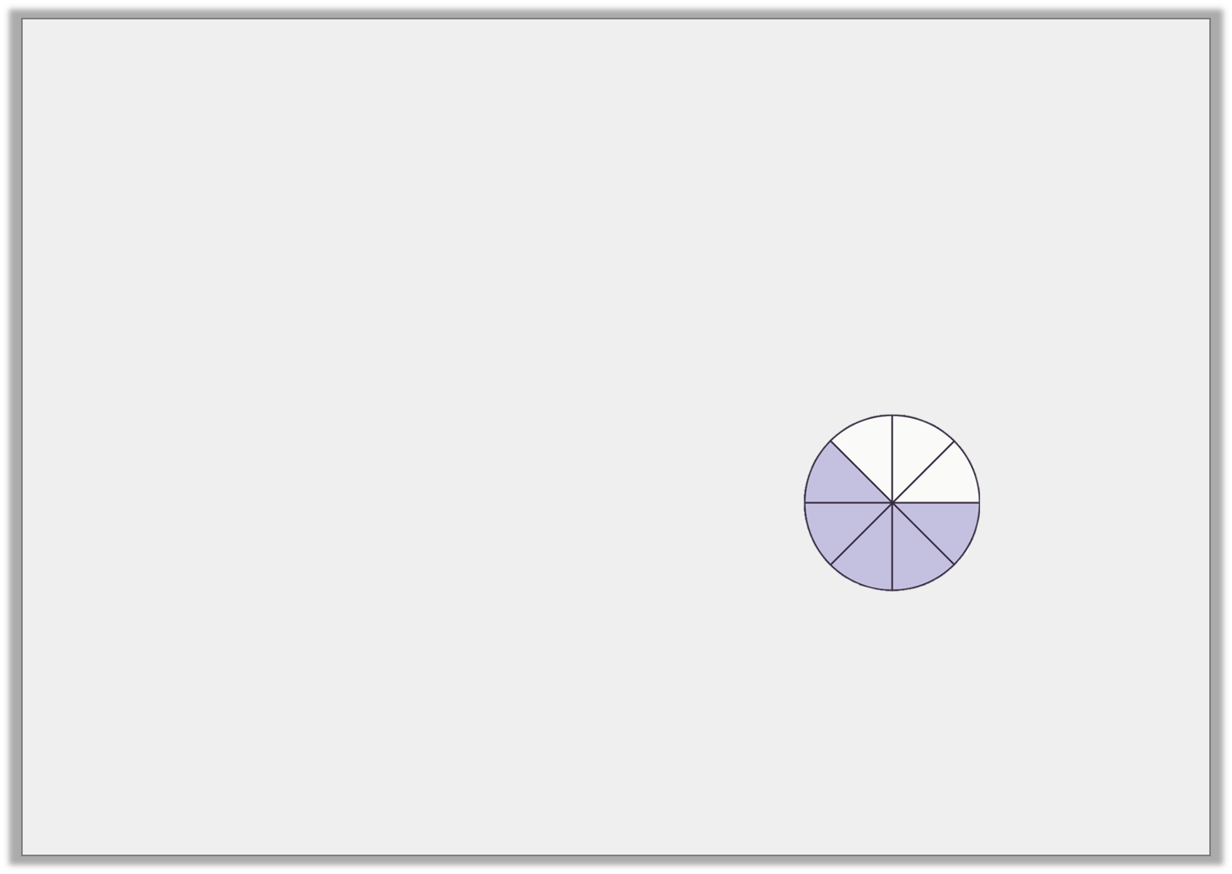
Problem Solving 1
Which image is the odd one out?
A.
B.
C.
D.
5
8
0 |  |  |  |  |  |  |  | 1
Look closely and follow the steps you have been practising.
© Classroom Secrets Limited 2019

Slide 18
Problem Solving 1
Which image is the odd one out?
A:$\frac{3}{8} or\text{:}\frac{5}{8}$
B::$\frac{6}{8}$
C:$\frac{5}{8}$
D:$\frac{5}{8}$
The odd one out is B
A.
B.
C.
D.
5
8
0 |  |  |  |  |  |  |  | 1
© Classroom Secrets Limited 2019

Slide 19
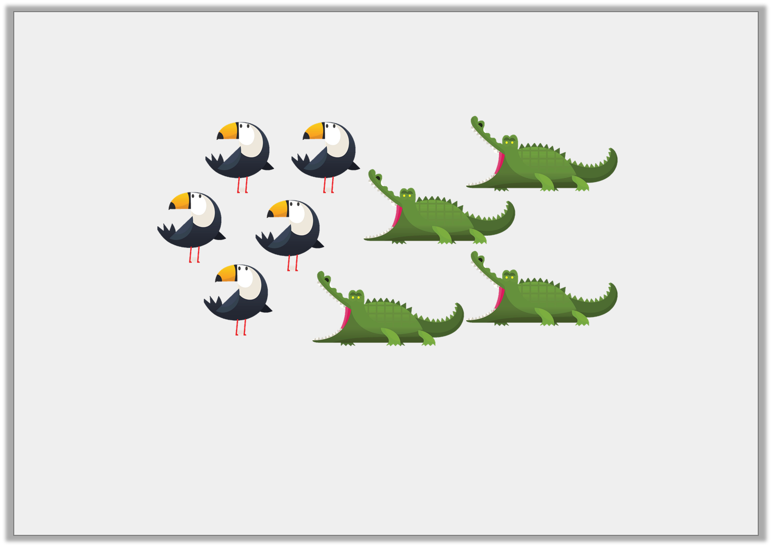
Reasoning 1
Josh thinks one of the fractions being represented below is .
Is he correct? Prove it.
4
5
How can we prove something?
© Classroom Secrets Limited 2019

Slide 20
Reasoning 1
Josh thinks one of the fractions being represented below is .
Is he correct? Prove it.
4
5
We can prove it by showing the fractions.
Your turn!
© Classroom Secrets Limited 2019

Slide 21
Reasoning 1
Josh thinks one of the fractions being represented below is .
Is he correct? Prove it.
Josh is incorrect because the whole is 9.
The fraction should be or .
4
5
5
9
4
9
© Classroom Secrets Limited 2019

Slide 22
Reasoning 2
Tara has placed a fraction on the number line.
Is she correct? Explain how you know.
3
12
0 |  |  |  |  |  |  |  |  |  |  |  | 1
Maths Vocabulary
correct
incorrect
I know this because…….
fraction
denominator
numerator
© Classroom Secrets Limited 2019

Slide 23
Reasoning 2
Tara has placed a fraction on the number line.
Is she correct? Explain how you know.
Tara is incorrect because the denominator is 12 and the line is split into 6 sections. She placed the fraction in the middle of the number line which would be .
3
12
0 |  |  |  |  |  |  |  |  |  |  |  | 1
6
12
© Classroom Secrets Limited 2019

