Slide 1
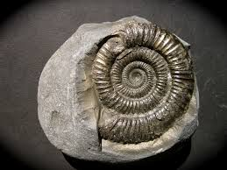
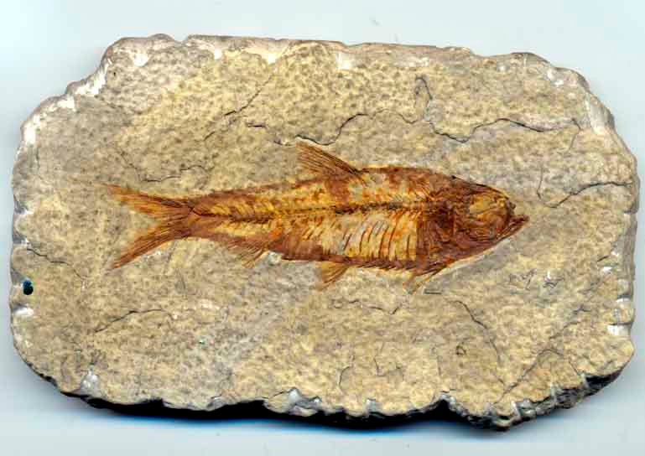
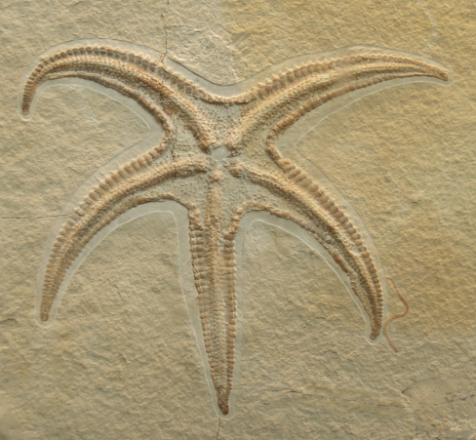
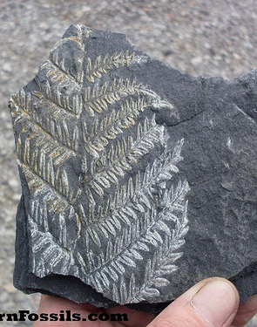
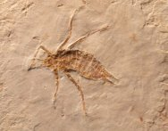
Starter
What are these? What do you know about them? What do you think we can learn from them?
Notes:
Have fossils on tables too!

Slide 2
What questions do you have about fossils?
I can recall what a fossil is.
I can also generate scientific questions about fossils.
I can even explain what we can learn from fossils.
W.S – generating scientific questions!

Slide 3
OBSERVATION AND DISCUSSION!
On the next slides you have some pictures of fossils to carry out observations on.
Observe them carefully and DISCUSS them ...
Think of some adjectives to describe the fossils.
Do the fossils resemble anything that you recognise that is alive today or are they different? How are they different?
What questions do you have about the fossils?

Slide 4
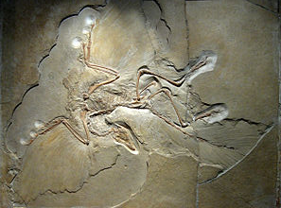
Notes:
Cut them out and give to children in groups. B. Archaeopteryx – transitional between feathered dinosaur and bird

Slide 5
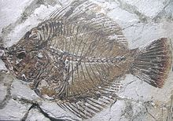
Notes:
Amphistium – transitional fish – flat fish now have eyes on one side – this fish has one big eye in the centre.

Slide 6
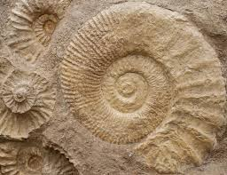
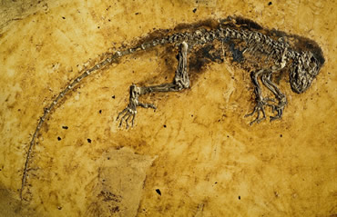

Slide 7
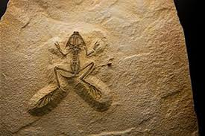

Slide 8
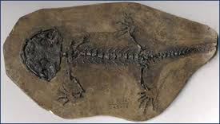

Slide 9
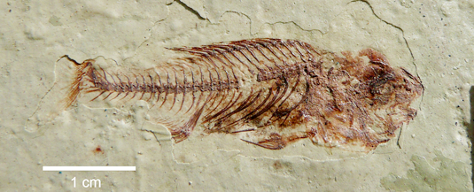
Notes:
10-12 million years ago https://www.en.uni-muenchen.de/news/spotlight/2013_articles/fish_fossil.html

Slide 10
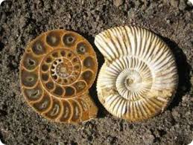

Slide 11
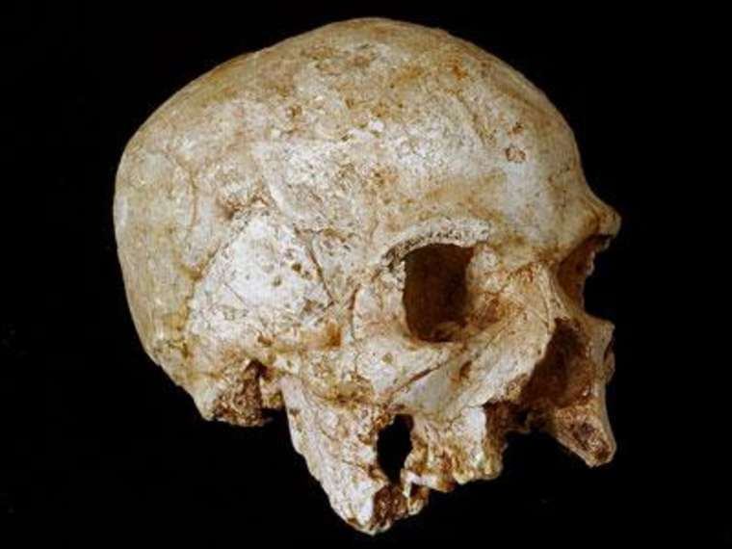

Slide 12
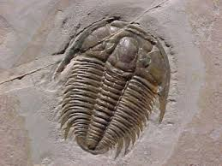

Slide 13
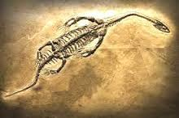

Slide 14
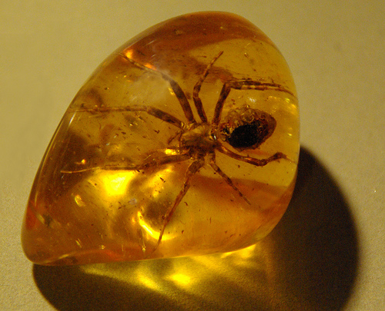

Slide 15
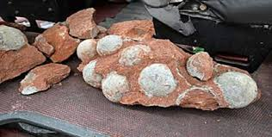

Slide 16
ACTIVITY! Choose one of the fossils...
Draw a diagram of your fossil (pencil and ruler)
Describe it in detail.
Does it look like anything that is alive today? How? What are the similarities and differences between your fossil and what we have alive today?
Challenge!
What questions do you have about fossils?
What do you think scientists can find out by studying fossils?
Notes:
Differentiated sheet available for lower ability/weaker literacy. Extension – PAGE 18 LIFE PROCESSES CHANNEL 4 LEARNING.

Slide 17
Description of the fossil.
………………………………………………………………………………………………………………………………………………………………………………………………………………………………………………………………
Does it look like anything that is alive today? Explain fully.
……………………………………………………….......
Questions I have…
1.
2.

