Slide 1
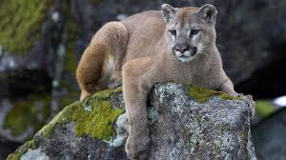
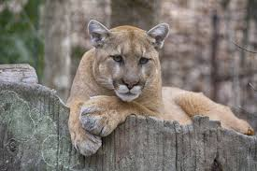
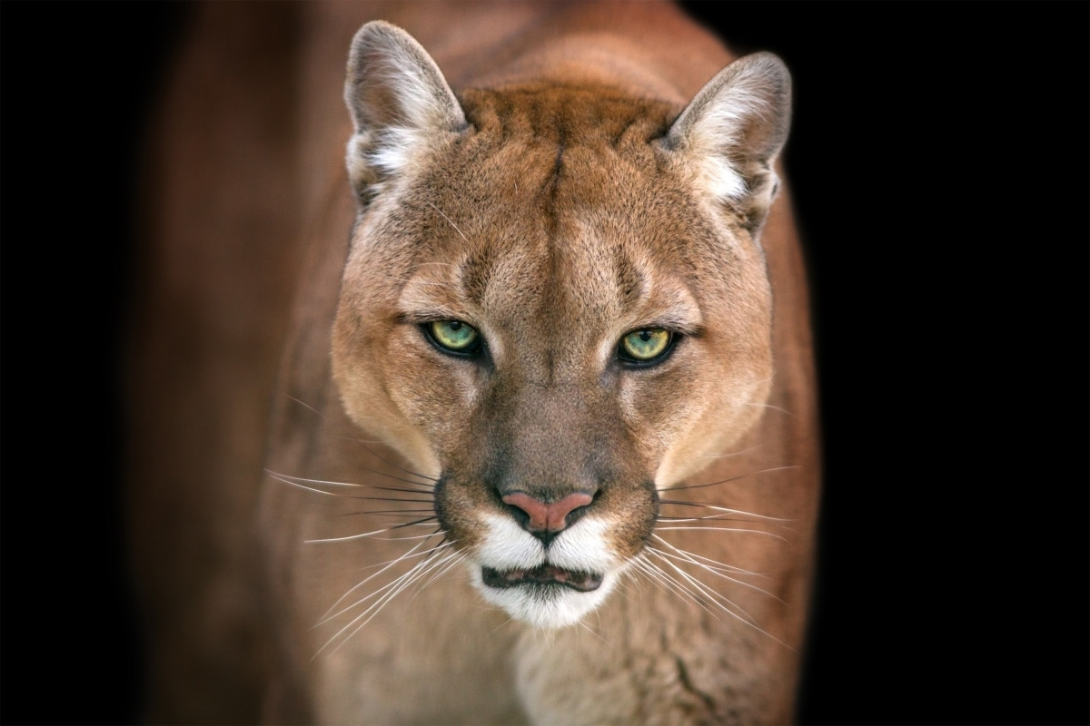
Mountain Lion
A Mountain Lion is also known as a Cougar,Puma,Panther or Catamount.It’s usually around 60-90cm tall, with a lifespan to 13-18 years old.Did you know that there is an estimated 30,000 Mountain Lions in the western United States, and it is the second heaviest cat in the word with a male weighing 53-100 kg and a female weighing 29-64 kg (adults)?

Slide 2
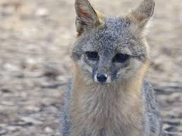
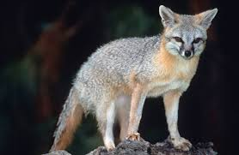
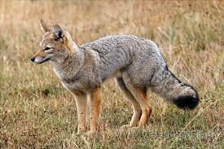
Grey Fox
A grey fox is a carnivorous mammal of the family Canidae, it is widely spread all around northern and central America, and their scientific name is a Urocyon Cinereoargenteus and they are the only living members of the genus Urocyon.Did you know that in all contrast to all Vulpes and related foxes, the grey foxes has oval pupils?

Slide 3
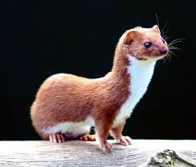
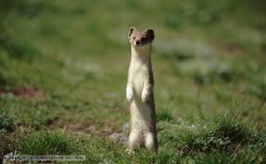
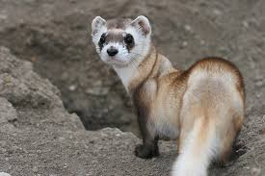
Weasel
The Weasel is a mammal of the genus mustela of the family mustelidae. Members of this family are small, active predators with long and slender bodies and short legs.Did you know that their scientific name is a Mustela? In the Uk it has a lifespan of 14 years but in other countries it only has a lifespan of 4-6 years of age.It’s got a height of 35-46cm.

Slide 4
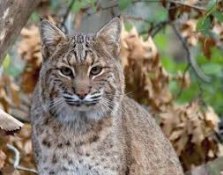
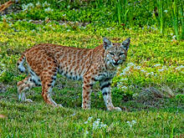
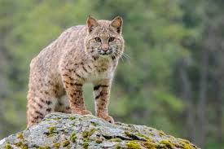
Bobcat
The Bobcat is a North American cat that appeared in the Irvingtonian stage of around 1.8 million years ago, containing 12 recognized subspecies. They have a mass of 8.6kg as an adult. They have a length of 69cm and their scientific name is a Lynx rufus.Did you know that baby Bobcats start to hunt at only 5 months old, and that their Trophic level is a carnivorous.

Slide 5
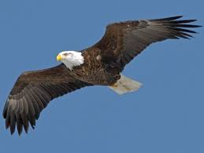
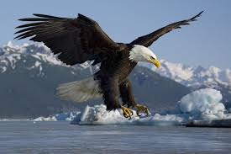
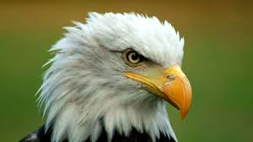
Bald Eagle
The Bald Eagle is a bird of prey found in North America, it forms a species with a white-tailed eagle. Fun fact their wingspan is 1.8-2.3m as an adult. They have a lifespan of 20 year, and their scientific name is a Haliaeetus leucocephalus, and this means white-headed sea eagle. They also have a mass of 3-6.3kg 120-160 km/h (diving).And right know their population is increasing instead of decreasing.

Slide 6
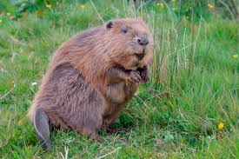
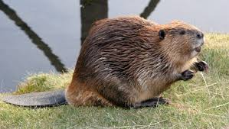
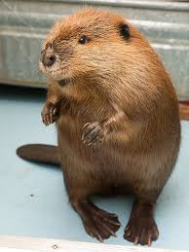
Beaver
The beaver is a large,primarily nocturnal, semi aquatic rodent. Fun fact, the scientific name for the “beaver” is a Castor which includes two extinct species, which are the North American beaver and the Eurasian beaver. Did you know that beavers are known for building dams, canals and lodges?Their gestation period is 107 for a eurasian beaver and 128 days for a North American beaver. And their length 80-100cm.

Slide 7
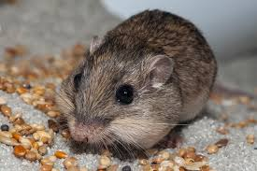
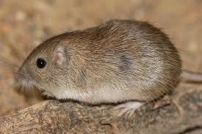
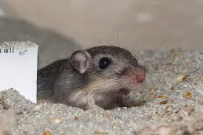
Pocket Mouse
The pocket mouse is one of the 19 species from the genus Chaetodipus. They are mainly found in the southwestern United States and Mexico.They are also medium sized and its nocturnal. And their scientific name is a Chaetodipus intermedius, and they are also a rodent but they look like normal mice but are very different. Did you know the pocket mouse at night time emerges to forage for seeds.

