Slide 1
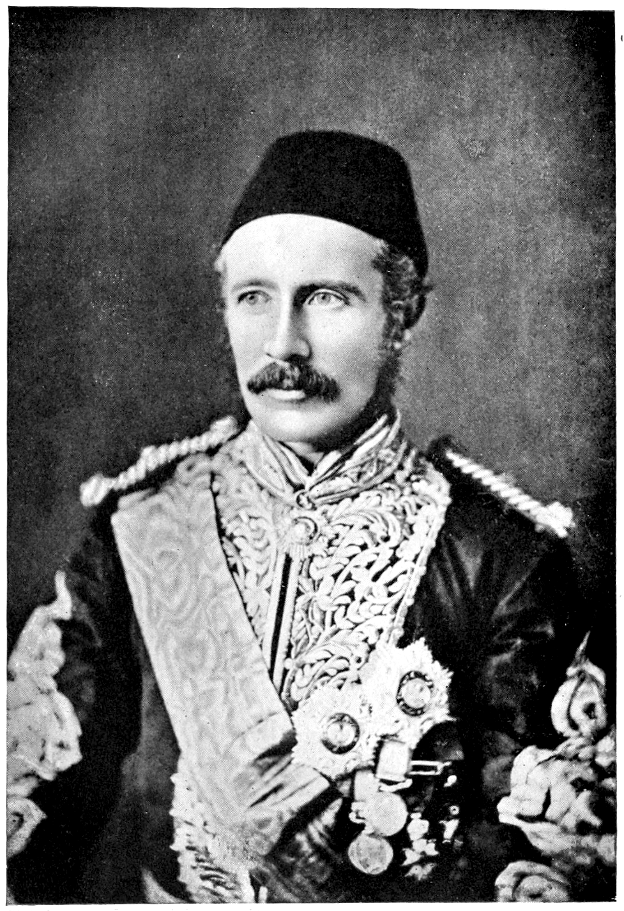
All about the Victorians
By Tommy and Faith

Slide 2
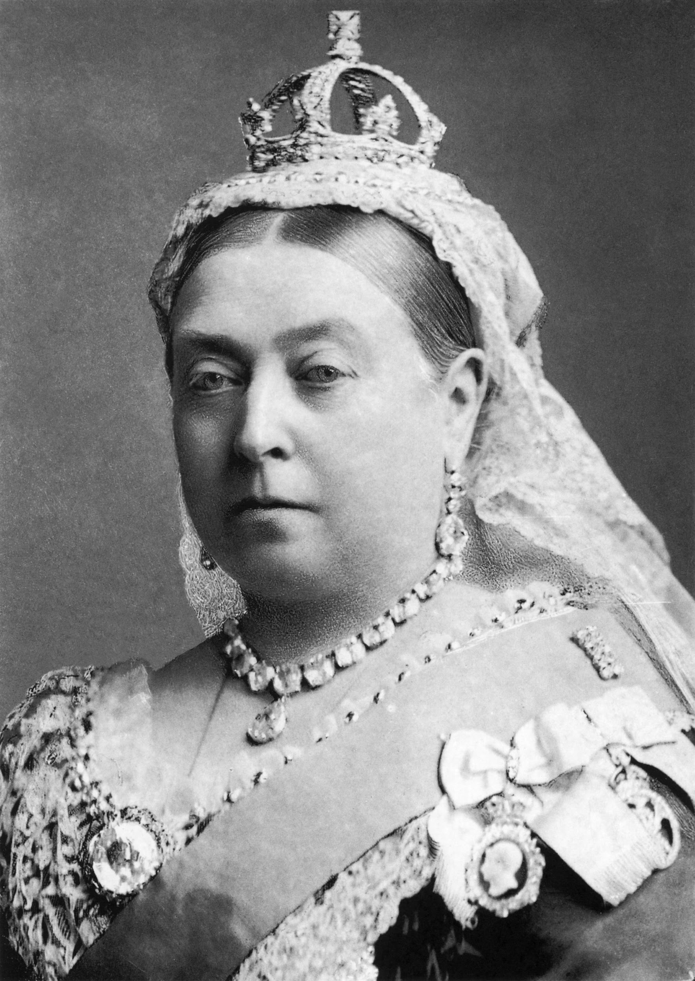
Queen Victoria
Queen Victoria became queen at 18 years old.
She has 4 grandchildren two boys and two girls
She was 62 when she died.

Slide 3
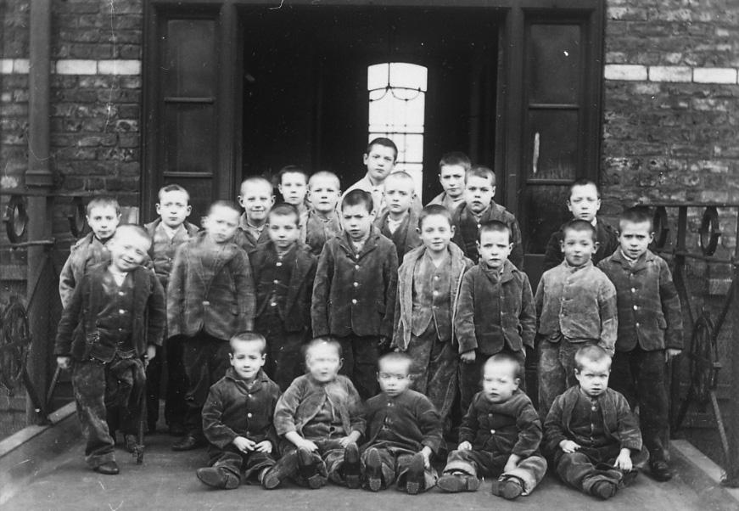
The workhouse
When you go to the workhouse you havet to work all day . You need to go to bed at 8 and wake up at 6. You have bread and water for breakfast.
Girls do sewing ,knitting and the dishes.
Boys do reading and writing. When they are old enough they go to the army

Slide 4
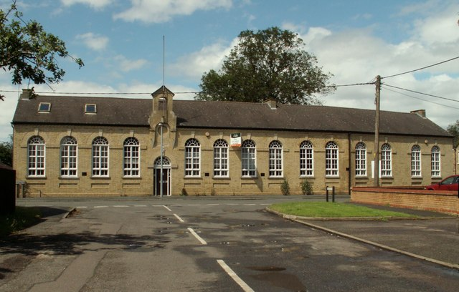
Victorian schools
In Victorian school you learnt writing and reading.
The boys and girls were separated.
When you went to school you had to pay but now you don`t.

Slide 5
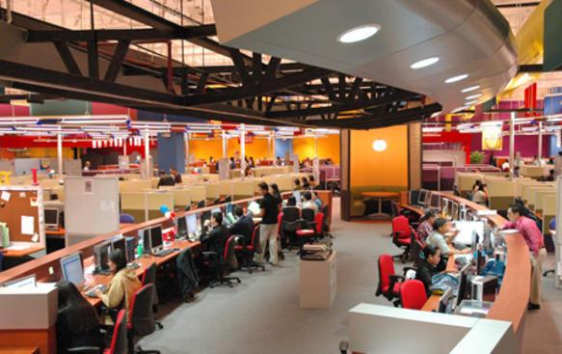
Punishments
If you were not good like back chating to the teachers, you would get the cane or a cone hat. If you get the cane you get hit. If you are a girl you get hit on the leg if you are a boy you get hit on your bottom.

Slide 6
Rich and poor
Along time ago there were some pepole rich and some pepole poor
Some pepole got sent to the work house.
The rich pepole got flush able toilets and the poor pepole didnt.

Slide 7
Beamish
On Monday 20th October 2019 we went to beamish.
In the school there was little black boards to write your ansers.

Slide 8
Thank you for watching our slide show

