Slide 1
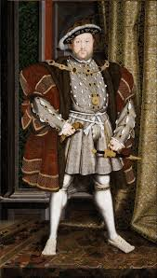
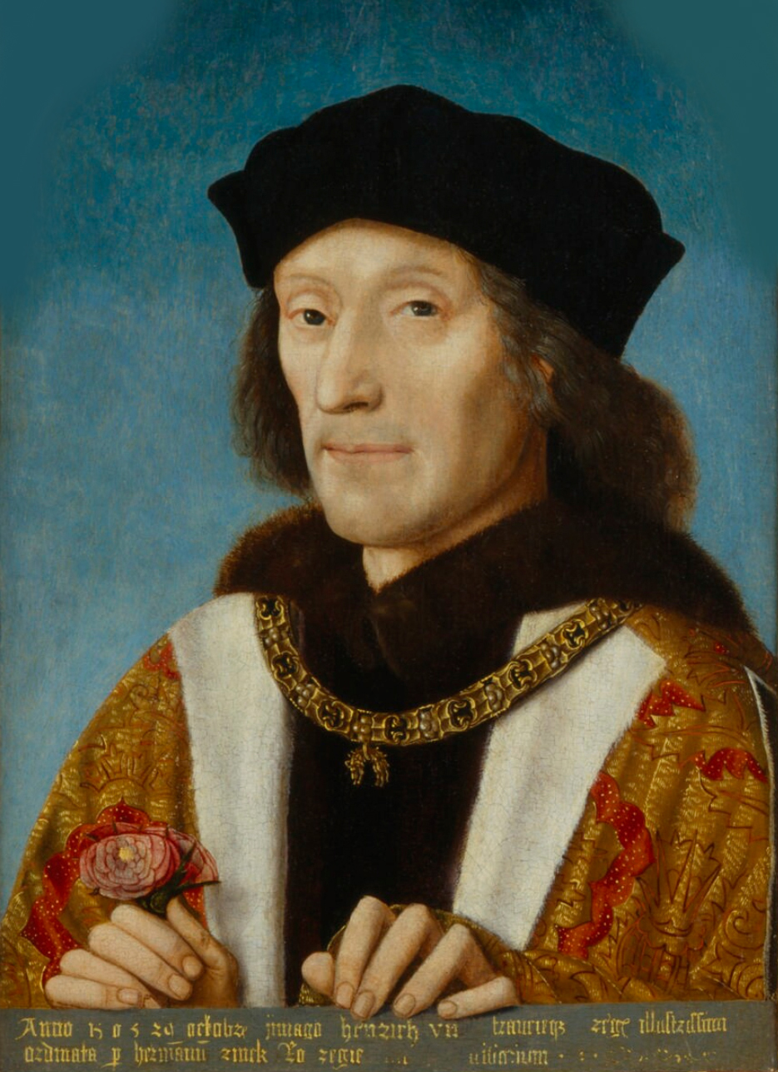
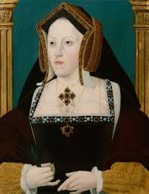
Crime and punishment !
Tudor times

Slide 2
What would Tudors do if someone had committed a crime?
they would either : boil you alive, hang you, burn you at a stake and even they would crush you by heavy stones .they were cruel people.
although it was horrible living in those times People believed if a criminal's punishment was severe and painful enough, the act would not be repeated and others would deter from crime as well.

Slide 3
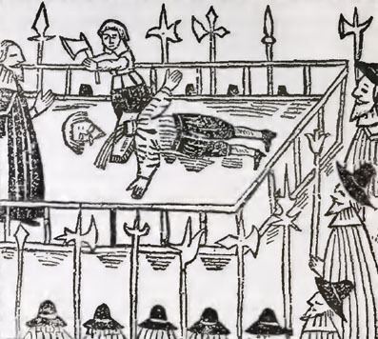
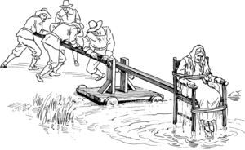
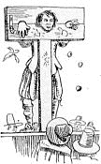
This is what they would do to you sometimes
Cucking stool
they will whip you
they will trap you and start throwing food at you
How you would get executed when King Henry VIII was around

Slide 4
What Tudor crimes were there?
Crimes of royalty and wealthy Tudors included treason (plotting to do something horrible to the king or queen), blasphemy (insulting God), spying, murder and witchcraft. Commoners often committed crimes because they were so poor and desperate.

Slide 5
Now we have come to the end I hope you have learnt a little bit about the terrible Tudors crimes and punishments that you could get back in those days.

Slide 6
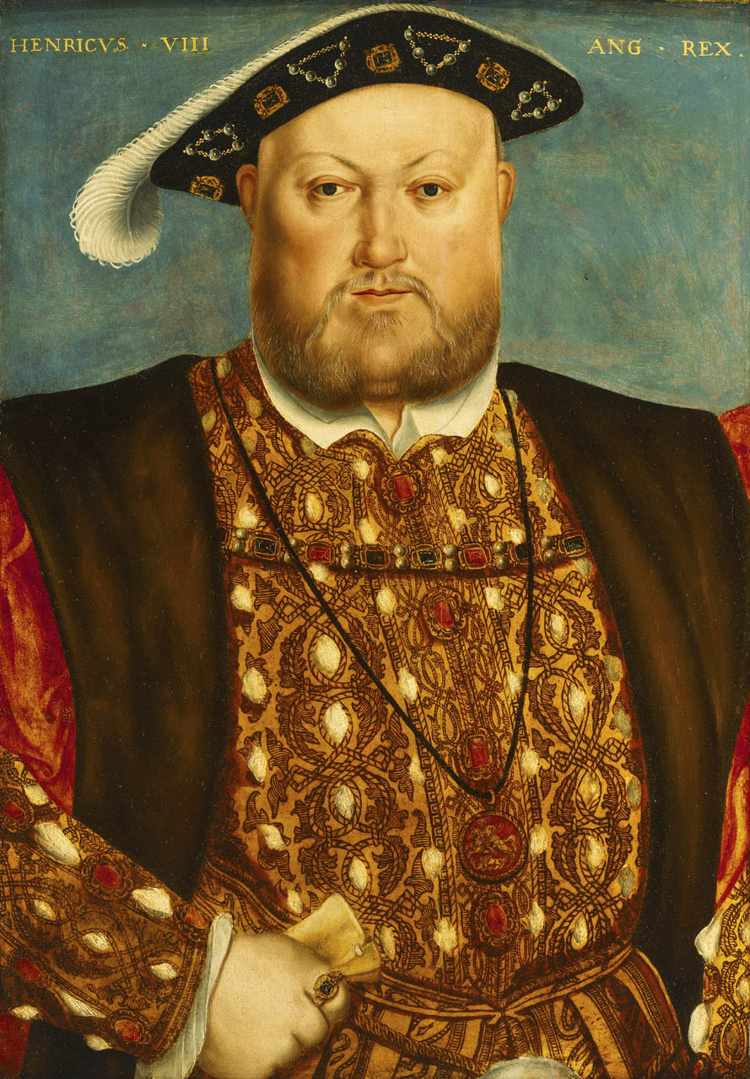
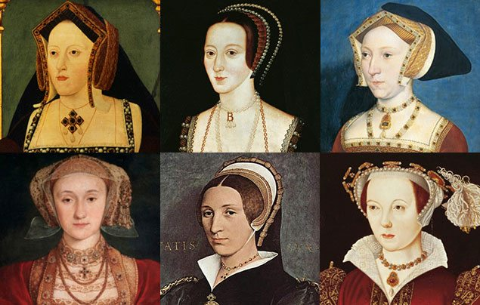
Now I know that this is not about the Tudor crimes and punishments but here are some facts about King Henry VIII
Henry had six wives: Catherine of Aragon, Anne Boleyn, Jane Seymour , Anne of Cleves , Catherine Howard and last but not least Catherine Parr.( which the first one was divorced the second was beheaded and the third one died and it repeats but Catherine Parr survived but
by the end of his life, Henry was obese. He had injured his leg in 1536, and this prevented him from exercising. The wound became ulcerated, and he died from natural causes in 1547.
And his father was King Henry VII

