Slide 1
Lesson 2:
Equivalent Fractions
© Classroom Secrets Limited 2019

Slide 2
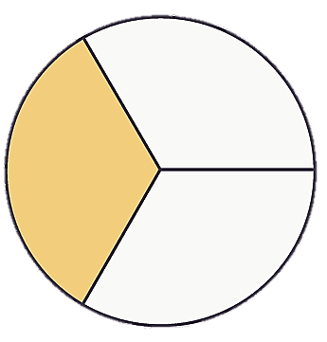
Let’s start warming those brains up!
Circle the different representations of below.
1
3
© Classroom Secrets Limited 2019

Slide 3
Circle the different representations of below.
1
3
© Classroom Secrets Limited 2019

Slide 4
Which images show ?
2
9
© Classroom Secrets Limited 2019

Slide 5
Which images show ?
is 2 of 9 equal parts.
2
9
2
9
© Classroom Secrets Limited 2019

Slide 6
Complete the diagram to show the equivalent fraction.
What is the fraction in the first diagram?
© Classroom Secrets Limited 2019

Slide 7
Complete the diagram to show the equivalent fraction.
1
5
What is the fraction in the first diagram?
© Classroom Secrets Limited 2019

Slide 8
Complete the diagram to show the equivalent fraction.
1
5
What is the fraction in the first diagram?
Now work out the denominator for the second diagram.
© Classroom Secrets Limited 2019

Slide 9
Complete the diagram to show the equivalent fraction.
1
5
What is the fraction in the first diagram?
Now work out the denominator for the second diagram.
Discuss/think- How can we find the denominator?
15
© Classroom Secrets Limited 2019

Slide 10
Complete the diagram to show the equivalent fraction.
1
5
3
15
1
5
What is the fraction in the first diagram?
Now work out the denominator for the second diagram.
Discuss/think- How can we find the denominator?
Because the shapes are the same size. We can colour in the same amount. Now count how many sections are coloured in. This is your numerator. 3
15
© Classroom Secrets Limited 2019

Slide 11
Using your knowledge of multiples how many equivalent fractions can you create?
Write a fraction which is equivalent to .
1
6
1 | x | 2 | = | 2
6 | x | 2 |  | 12
1 | x | 3 | = | 3
6 | x | 3 |  | 18
Don’t forget the golden rule:
What you multiply the numerator by you multiply the denominator by.
© Classroom Secrets Limited 2019

Slide 12
Did you find some of the same ones I did?
Write a fraction which is equivalent to .
Various answers, for example:
1
6
2
12
3
18
4
24
5
30
6
36
© Classroom Secrets Limited 2019

Slide 13
Now lets try looking at some equivalent fractions using our knowledge of multiplication.
What have the numerator and denominator been multiplied by to make the equivalent fraction?
1 | x |  | = | 4
7 | x |  |  | 28
© Classroom Secrets Limited 2019

Slide 14
What have the numerator and denominator been multiplied by to make the equivalent fraction?
1 | x | 4 | = | 4
7 | x | 4 |  | 28
© Classroom Secrets Limited 2019

Slide 15
Circle the fractions which are equivalent to .
1
4
4
16
4
8
2
8
2
5
3
12
How could we work this one out???????
Using our knowledge of multiples …..of course.
© Classroom Secrets Limited 2019

Slide 16
Circle the fractions which are equivalent to .
1
4
4
16
4
8
2
8
3
12
2
5
1 | x | 4 | = | 4
4 | x | 4 |  | 16
Try this with each fraction.
Don’t forget the golden rule:
What you multiply the numerator by you multiply the denominator by.
Remember it might not always be 4
© Classroom Secrets Limited 2019

Slide 17
Were you correct?
Circle the fractions which are equivalent to .
1
4
4
16
4
8
2
8
2
5
3
12
© Classroom Secrets Limited 2019

Slide 18
Fill in the missing divisor.
÷ ?
2 | = | 4
5 |  | 10
÷ ?
Y5
© Classroom Secrets Limited 2019

Slide 19
Fill in the missing divisor.
÷ 2
2 | = | 4
5 |  | 10
÷ 2
Y5
© Classroom Secrets Limited 2019

Slide 20
Match the equivalent fractions.
2 |  | 9
5 |  | 99
1 |  | 2
11 |  | 3
6 |  | 6
9 |  | 15
Y5
© Classroom Secrets Limited 2019

Slide 21
Match the equivalent fractions.
2 |  | 9
5 |  | 99
1 |  | 2
11 |  | 3
6 |  | 6
9 |  | 15
Y5
© Classroom Secrets Limited 2019

Slide 22
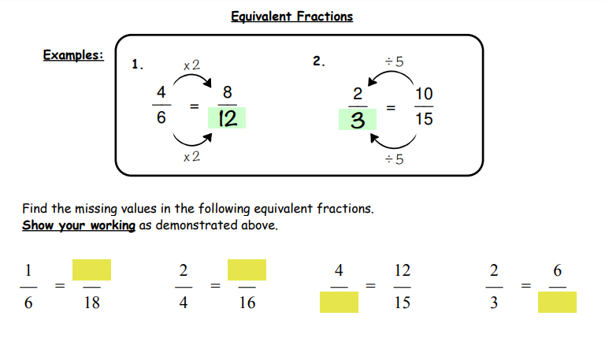
.
Now try these: This is submitted work so please send me a picture of your workings.
Y5
© Classroom Secrets Limited 2019

