Slide 1
Week 5 – Home Learning
Warm your brains up thinking about the following questions:
Warm Up Challenge

Slide 2
Teaching Input:
Week 5 – Home Learning

Slide 3
Week 5 – Home Learning

Slide 4
Teaching Input:
Week 5 – Home Learning

Slide 5
Teaching Input:
Week 5 – Home Learning

Slide 6
Teaching Input:
Week 5 – Home Learning

Slide 7
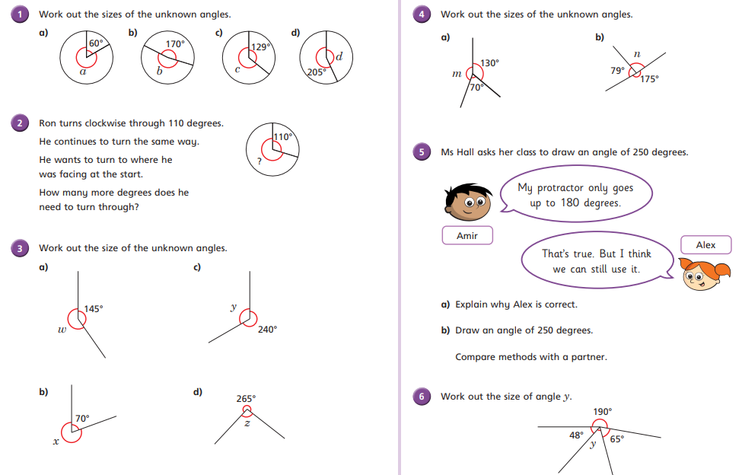
Independent Activity: Now grab a pen and paper and see how many questions you can answer
Week 5 – Home Learning

