Slide 1
Lets warm those brains up
Match the equivalent fractions.
2
8
1
4
2
3
3
6
8
12
1
2
3
12
1
4
© Classroom Secrets Limited 2019

Slide 2
Introduction
Match the equivalent fractions.
2
8
1
4
2
3
3
6
8
12
1
2
3
12
1
4
Y4
© Classroom Secrets Limited 2019

Slide 3
What is an improper fraction??????
Y4
© Classroom Secrets Limited 2019

Slide 4
How can we match these?
.
A
B
C
16
5
12
8
6
3
We use the steps that we learnt in lesson 1.
Y5
© Classroom Secrets Limited 2019

Slide 5
Match the picture to the improper fraction.
A
B
C
16
5
12
8
6
3
Y5
© Classroom Secrets Limited 2019

Slide 6
Match the image to the correct shaded fraction.
 | 7
 | 5
 | 4
 | 2
1 | 3
 | 4
© Classroom Secrets Limited 2019

Slide 7
Varied Fluency 2
Match the image to the correct shaded fraction.
 | 7
 | 5
 | 4
 | 2
1 | 3
 | 4
© Classroom Secrets Limited 2019

Slide 8
Varied Fluency 3
True or false? The following diagram represents
two wholes and one third.
© Classroom Secrets Limited 2019

Slide 9
Varied Fluency 3
True or false? The following diagram represents
two wholes and one third.
False, it shows 2 wholes and .
2
3
© Classroom Secrets Limited 2019

Slide 10
Show these improper fractions as a diagram and write
as a mixed number.
a. | 7
 | 4
b. | 11
 | 3
c. | 14
 | 11
Y5
© Classroom Secrets Limited 2019

Slide 11
Varied Fluency 1
Show these improper fractions as a diagram and write
as a mixed number.
a. | 7
 | 4
b. | 11
 | 3
c. | 14
 | 11
3
4
1
2
3
3
3
11
1
© Classroom Secrets Limited 2019

Slide 12
Varied Fluency 2
Using the diagrams we practised in the last slide.
Convert these improper fractions into mixed numbers.
a. | 14 |  | b. | 19 |  | c. | 17 |  | d. | 23
 | 8 |  |  | 12 |  |  | 5 |  |  | 7
Y5
© Classroom Secrets Limited 2019

Slide 13
Varied Fluency 2
Convert these improper fractions into mixed numbers.
a. | 14 |  | b. | 19 |  | c. | 17 |  | d. | 23
 | 8 |  |  | 12 |  |  | 5 |  |  | 7
a. 1 | 6 |  | b. 1 | 7 |  | c. 3 | 2 |  | d. 3 | 2
 | 8 |  |  | 12 |  |  | 5 |  |  | 7
1 | 3
 | 4
Y5
© Classroom Secrets Limited 2019

Slide 14
Varied Fluency 3
Which answer matches the diagram?
a. | 28 |  | b. | 12 |  | c. | 31 |  | d. | 20
 | 7 |  |  | 7 |  |  | 7 |  |  | 7
Y5
© Classroom Secrets Limited 2019

Slide 15
Varied Fluency 3
Which answer matches the diagram?
a. | 28 |  | b. | 12 |  | c. | 31 |  | d. | 20
 | 7 |  |  | 7 |  |  | 7 |  |  | 7
Y5
© Classroom Secrets Limited 2019

Slide 16
Reasoning 1
Find and correct the mistakes. Explain your answer.
a. | 19 |  | = |  | 2 | 1
 | 9 |  |  |  |  | 9
b. | 24 |  | = |  | 3 | 4
 | 7 |  |  |  |  | 7
c. | 31 |  | = |  | 3 | 8
 | 8 |  |  |  |  | 7
d. | 24 |  | = |  | 2 | 4
 | 10 |  |  |  |  | 10
Y5
© Classroom Secrets Limited 2019

Slide 17
Reasoning 1
Find and correct the mistakes. Explain your answer.
B – the numerator should be 3.
C – the numerator and denominator have been mixed up.
a. | 19 |  | = |  | 2 | 1
 | 9 |  |  |  |  | 9
b. | 24 |  | = |  | 3 | 3
 | 7 |  |  |  |  | 7
c. | 8 |  | = |  | 3 | 7
 | 31 |  |  |  |  | 8
d. | 24 |  | = |  | 2 | 4
 | 10 |  |  |  |  | 10
Y5
© Classroom Secrets Limited 2019

Slide 18
What is an improper fraction??????
Y4
© Classroom Secrets Limited 2019

Slide 19
What is an Mixed number fraction??????
It shows you easily how many
wholes are in the fraction.
Y4
© Classroom Secrets Limited 2019

Slide 20
Show each image as a mixed number fraction and an improper fraction.
A.
= |  | =
Step 1: Lets find the denominator by counting how many sections each circle has been broken into.
Step 2: Then count how many whole numbers/ shapes there are.
Step 3: Count how many are shaded in the last circle (Not a whole)
Step 4: Write your mixed number.
Step 5: Convert to an improper fraction.
Y5
© Classroom Secrets Limited 2018

Slide 21
Did you get the same answer as me????
= | 2 | =
A.
5
6
17
6
Y5
© Classroom Secrets Limited 2018

Slide 22
Now try B and C- using the same steps.
A.
= |  | =
B.
= |  | =
C.
= |  | =
Y5
© Classroom Secrets Limited 2018

Slide 23
Were you correct?
= | 2 | =
A.
5
6
17
6
= | 2 | =
B.
5
9
23
9
= | 3 | =
C.
1
4
13
4
Y5
© Classroom Secrets Limited 2018

Slide 24
True or false? Show your working.
3 | 4 | = | 12
 | 5 |  | 5
Let’s use our multiplication skills.
Step 1: Start by multiplying the whole number by the denominator.
3 x 5 = 15.
Step 2: Add your answer to the numerator.
15+ 4 = 19
Step 3: Write this as your new numerator (the denominator doesn’t change).
Then tell me True or false.
Y5
© Classroom Secrets Limited 2018

Slide 25
Varied Fluency 2
True or false? Show your working.
False
3 | 4 | = | 12
 | 5 |  | 5
3 | 4 | = | 19
 | 5 |  | 5
Y5
© Classroom Secrets Limited 2018

Slide 26
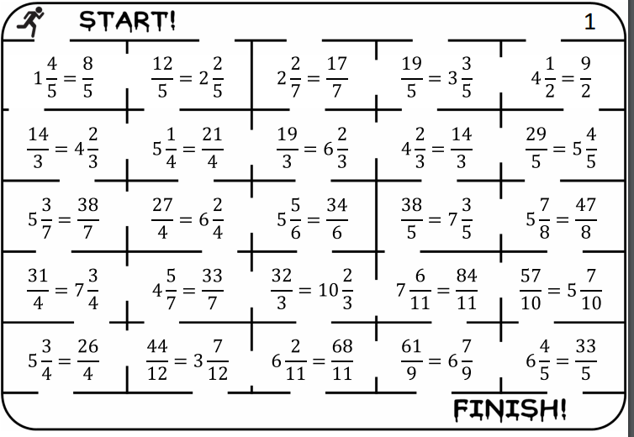
Now practise this skill with these true or false questions.
Don’t forget the steps
Y5
© Classroom Secrets Limited 2018

Slide 27
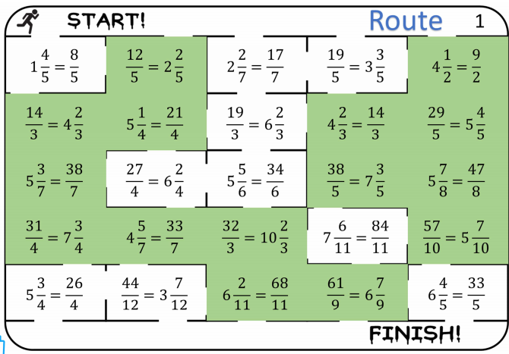
Did you find the correct route???
Y5
© Classroom Secrets Limited 2018

