Slide 1
Warm Up Challenge
Week 5 – Home Learning
Warm your brains up thinking about the following questions:

Slide 2
Week 5 – Home Learning
Warm your brains up thinking about the following questions:
Warm Up Challenge

Slide 3
Teaching Input:
Week 5 – Home Learning

Slide 4
Teaching Input:
Week 5 – Home Learning

Slide 5
Teaching Input:
Week 5 – Home Learning

Slide 6
Teaching Input:
Week 5 – Home Learning

Slide 7
Teaching Input:
Week 5 – Home Learning

Slide 8
Teaching Input:
Week 5 – Home Learning

Slide 9
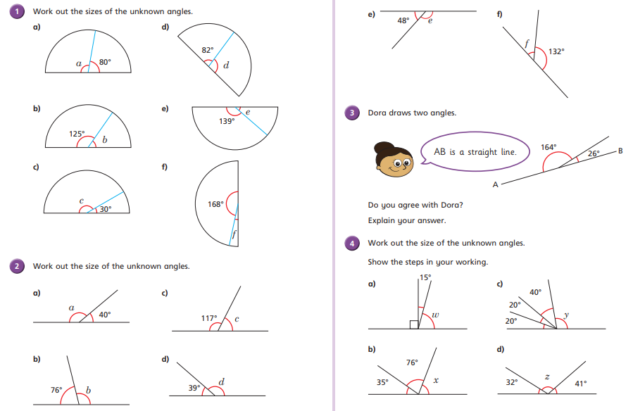
Independent Activity: Now grab a pen and paper and see how many questions you can answer
Week 5 – Home Learning

Slide 10
Independent Activity: Now grab a pen and paper and see how many questions you can answer
Week 5 – Home Learning

