Slide 1
The victorians
By Coburn and Freya

Slide 2
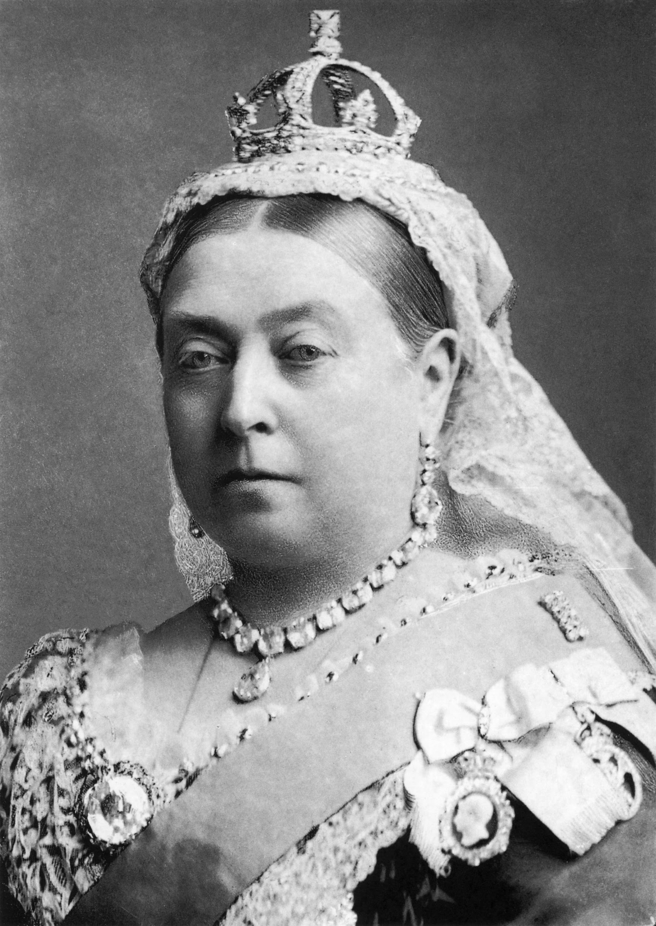
QUEEN VICTORIA
When Victoria's husband died she wear black and white for the rest of her life.
Victoria became queen when she was 18.
Queen Victoria hardworking queen.
Queen Victoria's husband is called King Albert.

Slide 3
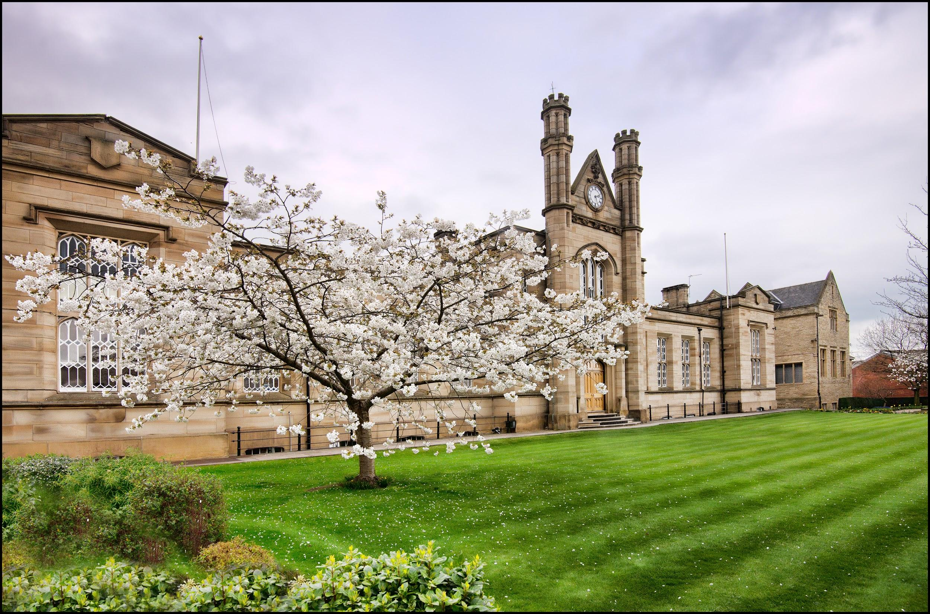
VICTORIAN SCHOOLS
In the victorian schools there was 70 to 80 people in a class.
There was more girl teachers than men.
In victorian schools the teachers were really strict.

Slide 4
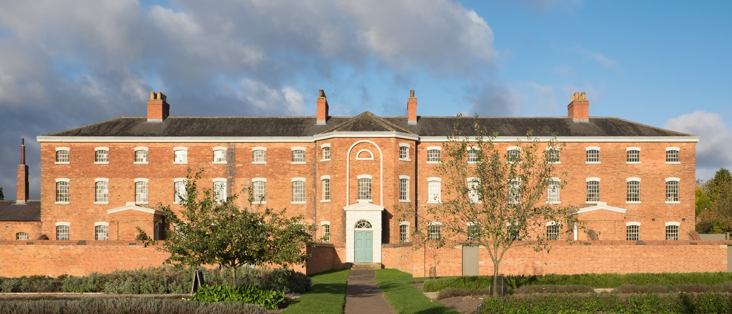
THE WORKHOUSE
Its a horrible place the workhouse.
Would you like to go their?
It looks nice on the outside but inside is the masters is stickly.
.

Slide 5
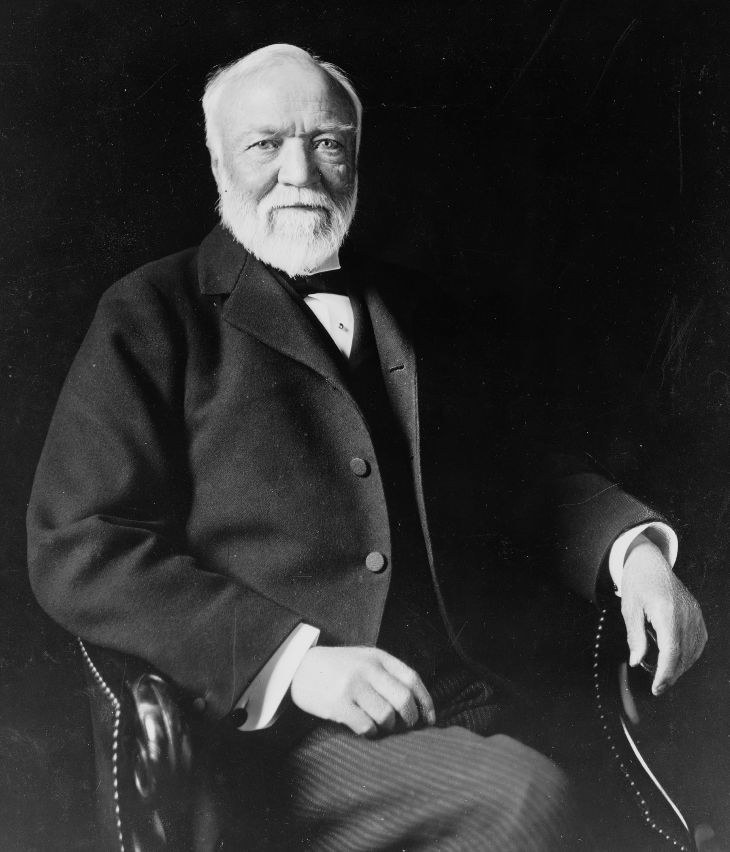
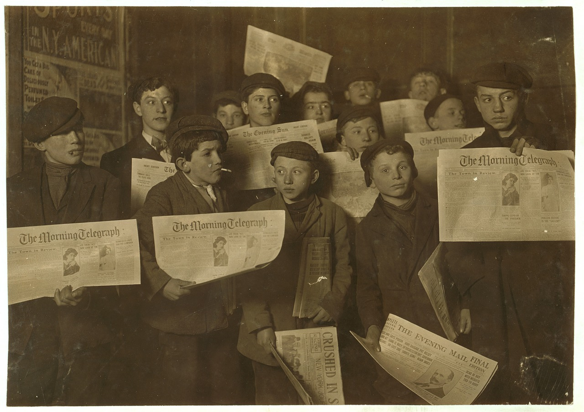
RICH VS POOR
Rich men wear hats and a suit and rich women wear dresses.
Poor people work in mines and factories if the dont have a job they go to the workhouses.
Rich peoples houses had massive gardens and poor people had tiny gardens.

Slide 6
TRIP TO BEAMISH
Our trip to Beamish.First we had our Victorian lesson.It was a little scary at first but then it was alright.We did some Arithmetic, Writing and drill.Next we had lunch.After that we went to the driffmine.When we got in there the man took out the lights.Then we went to the town and got put into our groups.We went inside sweet shops, car shops, dentists and houses.When we were going down to the pit village we went on the tram.

Slide 7
THE QUIZZ
What colours did queen Victoria wear when her husband died?
How many kids was there in every class in Victorian times?
What clothes did rich men wear?
Was there more girls or more boys in schools?

