Slide 1
The Victorians
Queen victo ria
By Amelie and Darci

Slide 2
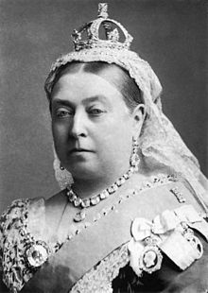
This is queen Victoria
Victoria was the daughter of Prince Edward, Duke of Kent and Strathearn, the fourth son of King George III. Both the Duke of Kent and King George III died in 1820, and Victoria was raised under close supervision by her German-born mother, Princess Victoria of Saxe-Coburg-Saalfeld. She inherited the throne at the age of 18, after her father's three elder brothers had all died, leaving no surviving legitimate children. The United Kingdom was already an established constitutional monarchy, in which the sovereign held relatively little direct political power. Privately, Victoria attempted to influence government policy and ministerial appointments; publicly, she became a national icon who was identified with strict standards of personal morality.
Victoria married her first cousin

Slide 3
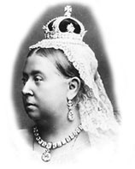
Queen Victoria was born on the 24 May in 1819. Her father died eight months after she was born.

Slide 4
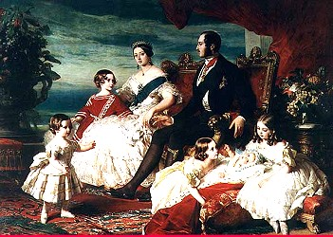
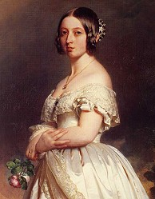
Her husband Albert died in 1861 at the young age of 42. She mourned his death for almost 10 years. For the rest of her reign she wore black.

Slide 5
Her reign of 63 years and seven months is known as the Victorian era and was longer than that of any of her predecessors. It was a period of industrial, cultural, political, scientific, and military change within the United Kingdom, and was marked by a great expansion of the British Empire. She was the last British monarch of the House of Hanover. Her son and successor, Edward VII, inaugurated the House of Saxe-Coburg and Gotha, the line of his father
Queen Victoria is very sad.

