Slide 1
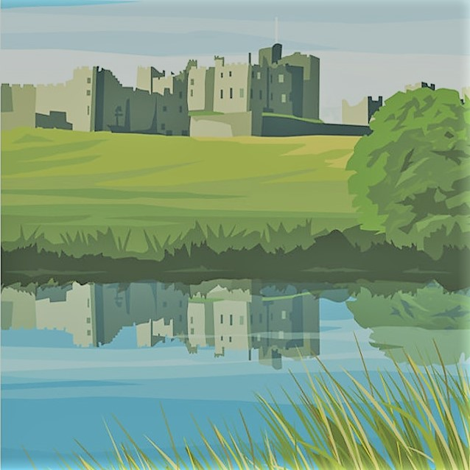
Divn’t Panic! You’ll Never Be Bored In Alnwick.
A full guide of tourist attractions in Alnwick

Slide 2
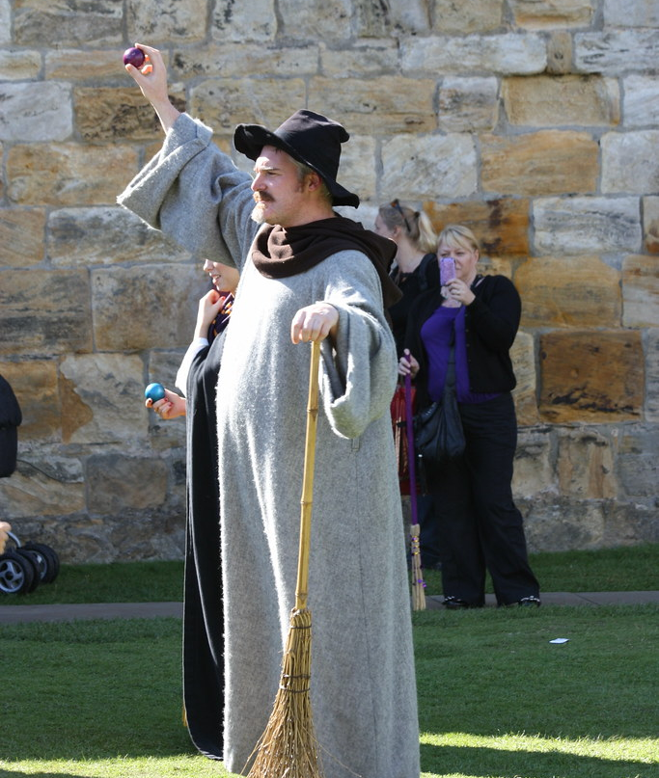
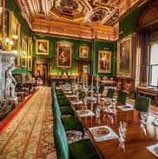
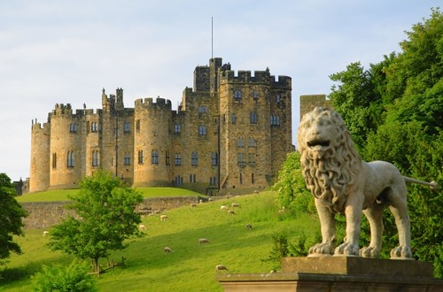
Alnwick Castle
Alnwick Castle is one of the largest inhabited castles in England. Home to the Duke of Northumberland's family, for over 700 years, it has witnessed drama, tragedy and romance. From stunning art collections to medieval crafts and Potter-inspired magic, a visit to Alnwick Castle fires the imagination.
Broomstick training, historic tours and medieval crafts
Open daily, 10 am- 5.30pm March 27th to Oct 30th
Alnwick Castle Ticket Prices
Adult - £18.50 Concession - £15.00 Child (5-16yrs) - £9.75 Child (4yrs and under)- Free Family (2 adults and up to 4 children)- £50.50

Slide 3
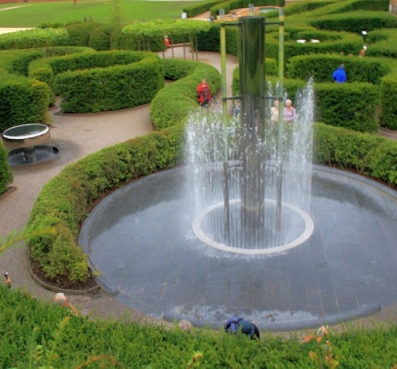
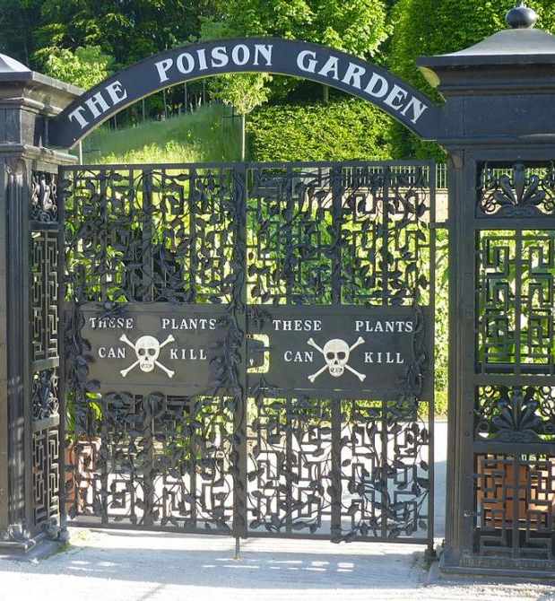
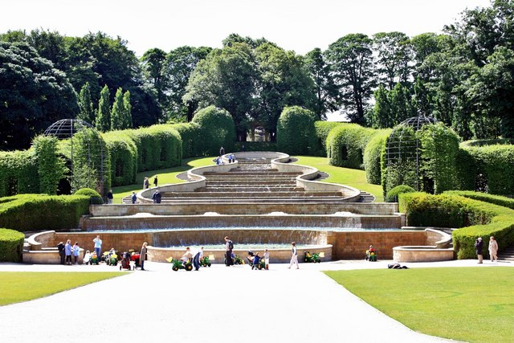
Alnwick Gardens
Adult | £14.30 | £13.00
Concession | £12.65 | £11.50
Child (5-16) | £5.50 | £5.00
Child (0-4) | FREE | FREE
Family | £36.30
The Alnwick Garden is one of the world’s most extraordinary contemporary gardens. From poisonous plants and treetop walkways to glorious flowers a magical experience full of imagination and fun, all brought to life with water.
Special events throughout the year (check website for details)
Pavilion Restaurant, Treehouse Restaurant, Gift shop, Crazy Golf, Poison gardens and much more
26th October – 28th March 10am – 4pm Daily 29th March – 25th October 10am – 6pm Daily
Alnwick Gardens ticket prices
Adult - £13.50 Concession - £11.50 Child (5-16yrs) - £5.00 Child (4yrs and under)- Free Family (2 adults and up to 4 children)- £33.00

Slide 4
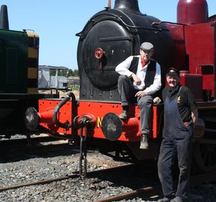
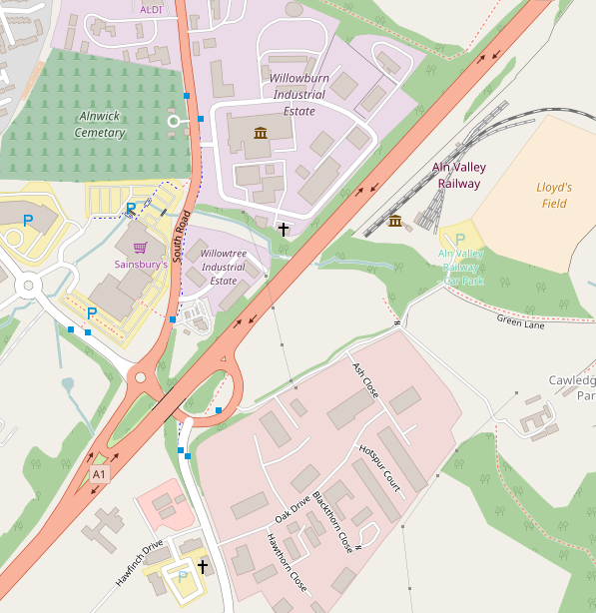
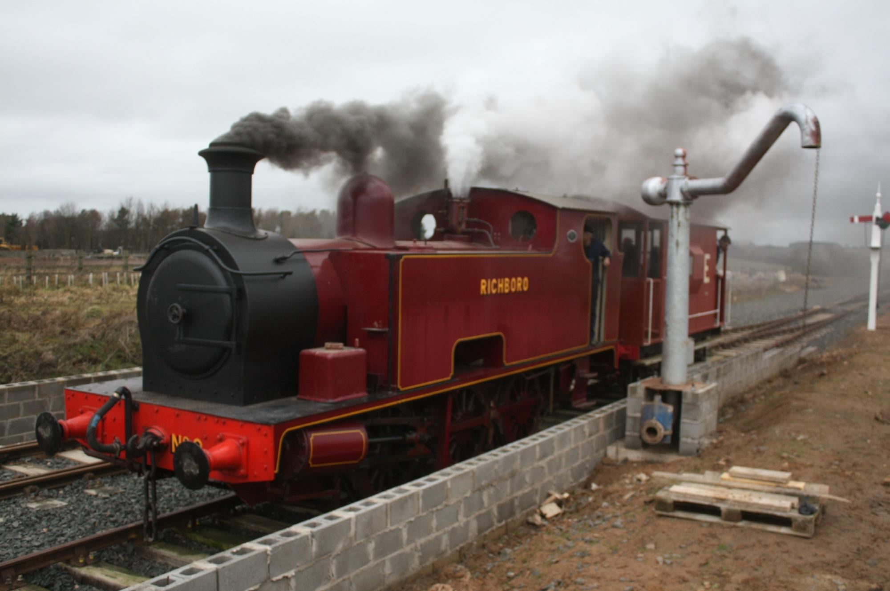
Aln Valley Railway
The Aln Valley Railway has re-opened the branch railway line which ran from Alnmouth on the Edinburgh to London main line up to Alnwick. Lionheart Station.
Rides are available at modest fares for short trips in a fully restored carriage behind a steam locomotive, or brake van rides hauled by diesel or on BUZZ, the Wickham trolley. The Buffet Stop cafe is open for teas, coffees, traybakes and sandwiches.
Open 10.30 – 4.30 on operating days (full list on website) Special events featured throughout the year.

Slide 5
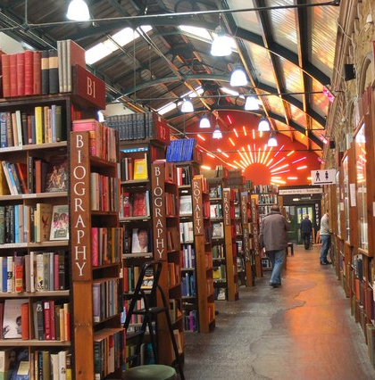
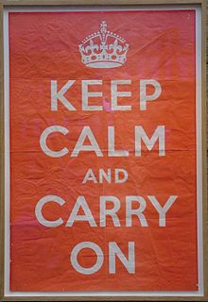
Barter Books
One of the largest second-hand bookshops in Britain and the home of the famous Keep Calm and Carry On poster.
The famous bookshop has many extra features: open fires in the winter, The Station Buffet serving excellent food, coffee, tea and cakes. Plus the newest addition Paradise, the ice cream parlour. A model railway acting as a link between the book columns of the central room, along with poetry lines, and access to computers.
Keep Calm and Relax at Barter Books
Free Entry
Open every day 9:00 - 7:00 incl. Sundays and all Bank Holidays (apart from Christmas Day)

