Slide 1
Victorians
By Robson and Isla

Slide 2
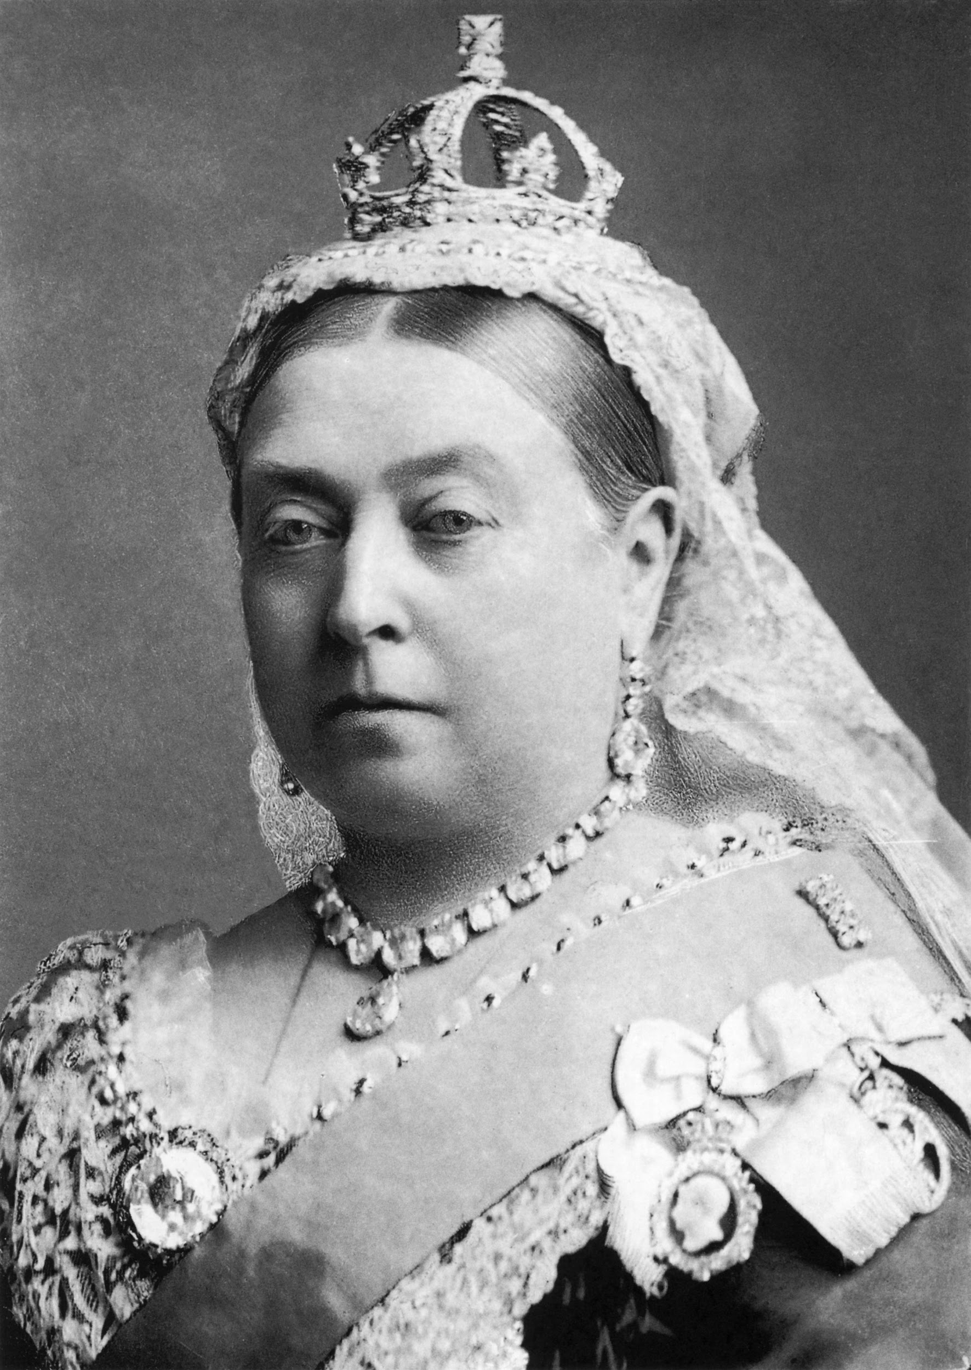
Queen Victoria
She was crowned at 18. She worn black clothes after Prince Albert died. She was very old and scary. She died in 1901.She was mary in 1840.

Slide 3
The workhouse
The workhouse is very hard. work in the workhouse.

Slide 4
Victorian school
The girls get caned on the thigh and hand.The boys get caned on the booty and hand.

Slide 5
Beamish Day
When we went to Beamish we had a good time.We went to a victorian school and a shop. We went on a tram.

